Slide 1
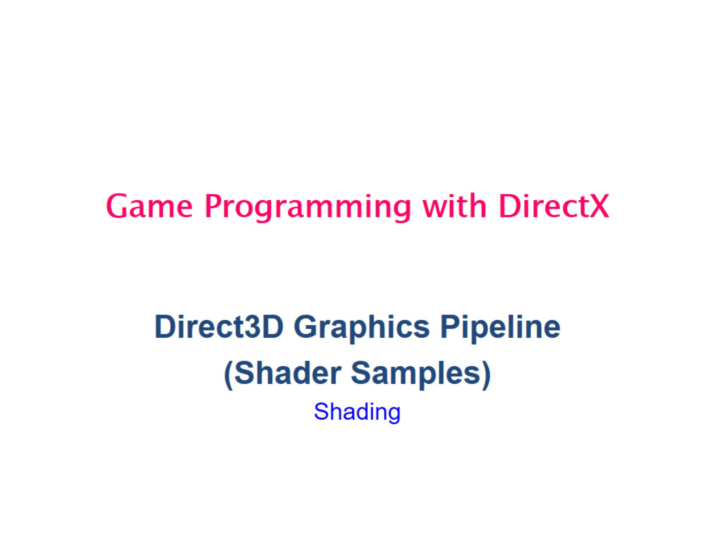
Game Programming with DirectX

Slide 2
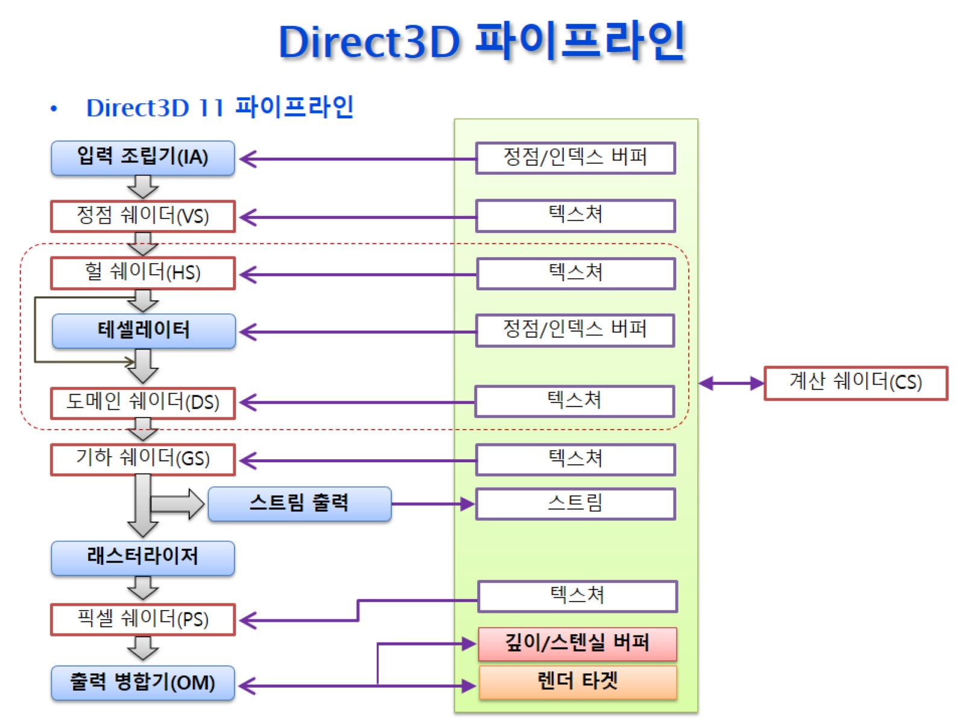
Direct3D 파이프라인

Slide 3
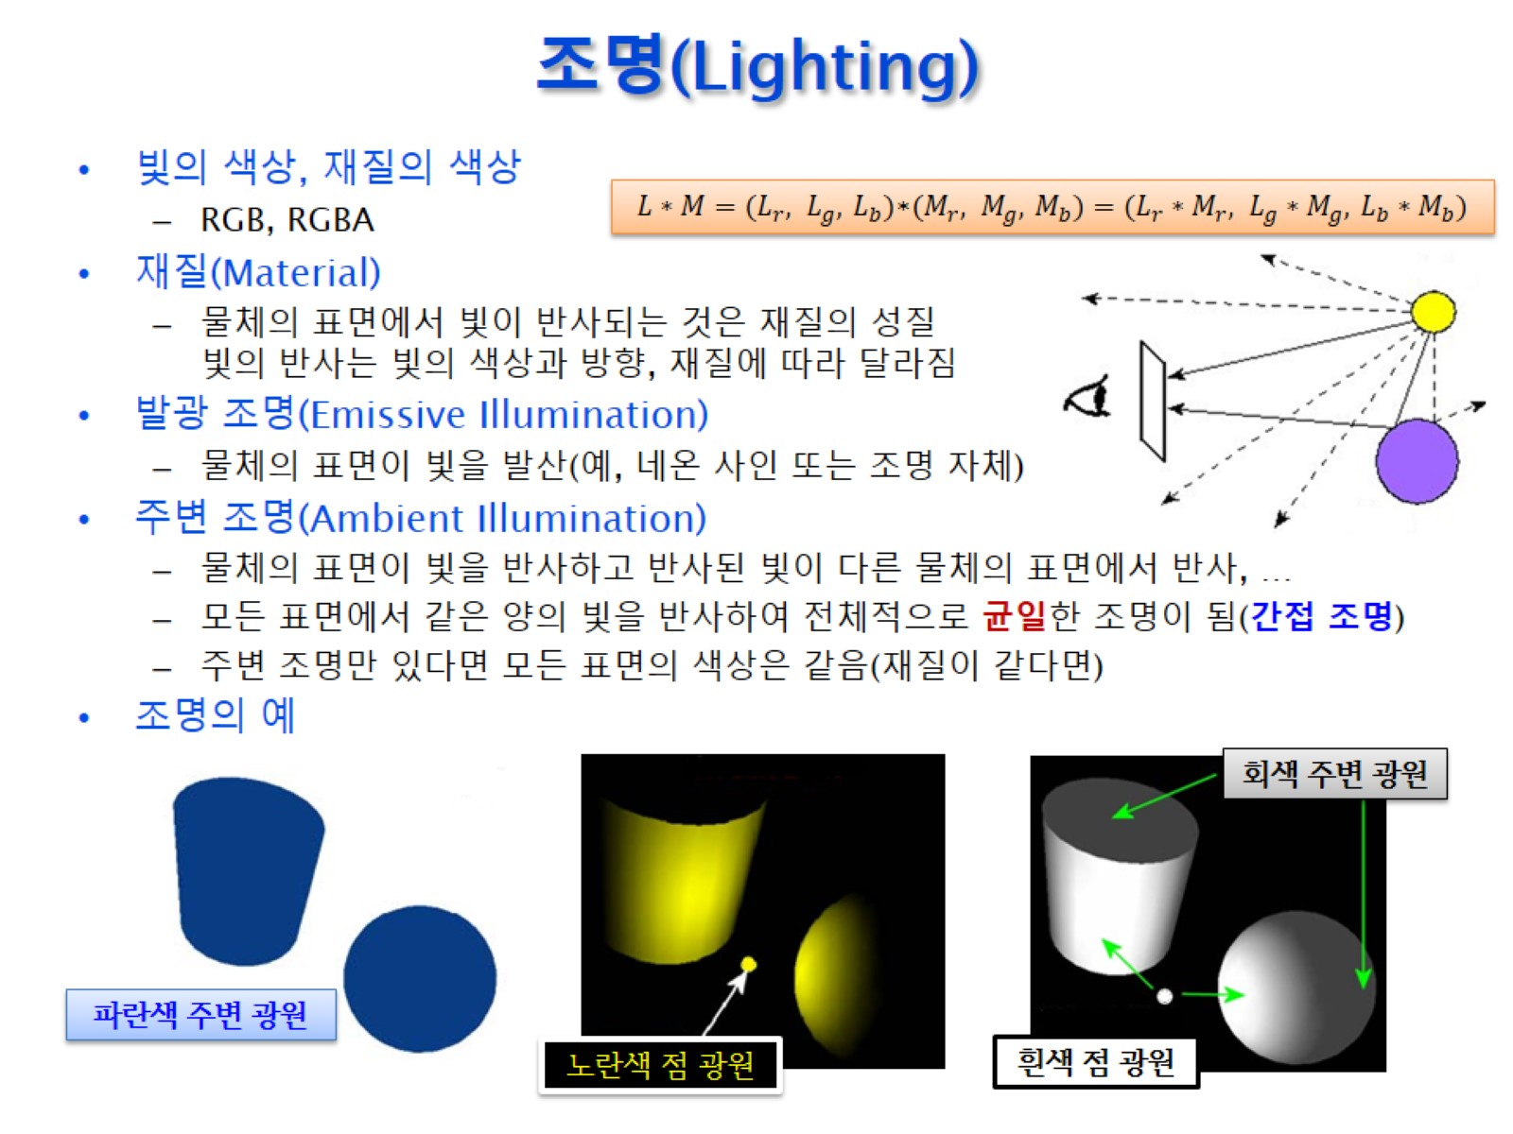
조명(Lighting)

Slide 4
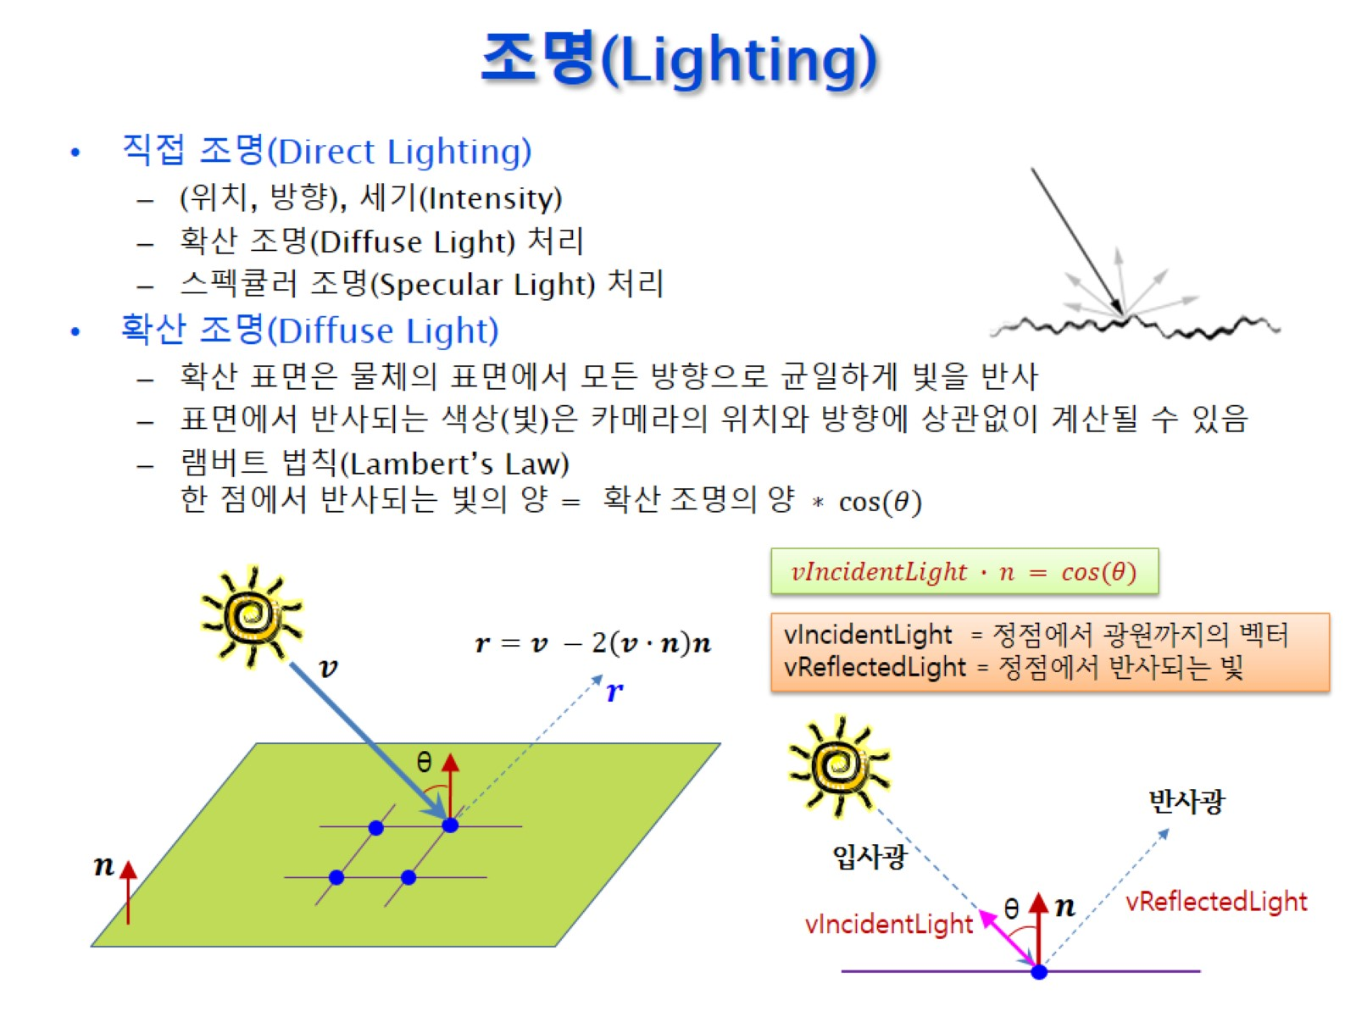
조명(Lighting)

Slide 5
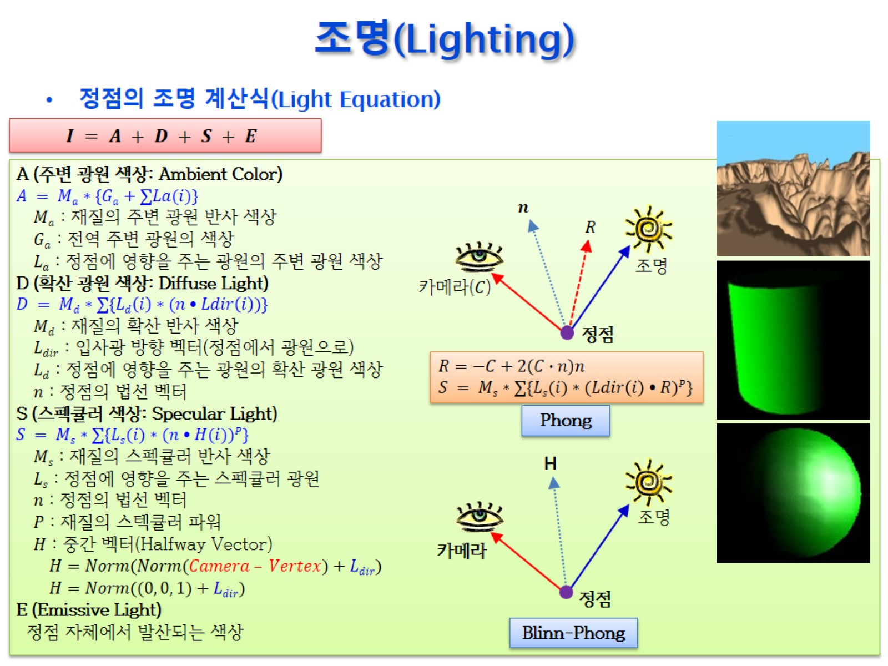
조명(Lighting)

Slide 6
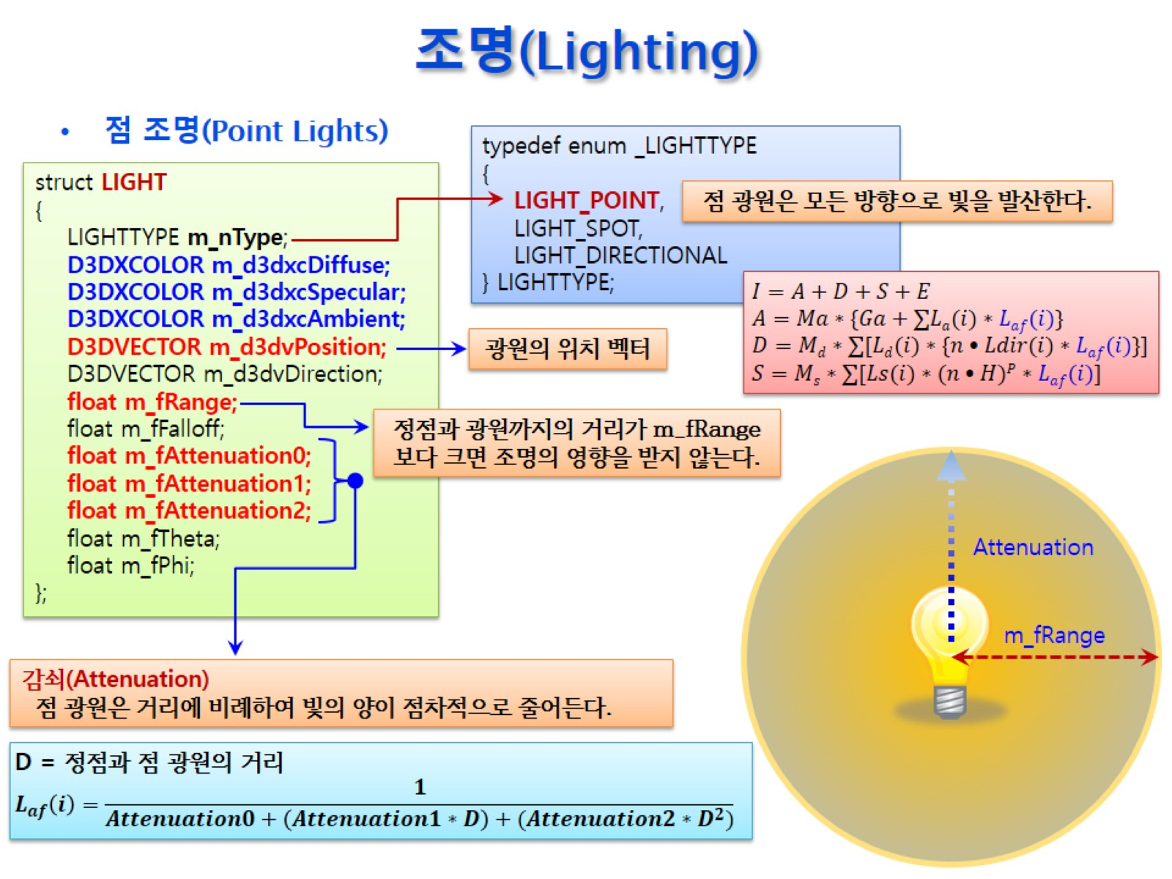
조명(Lighting)

Slide 7
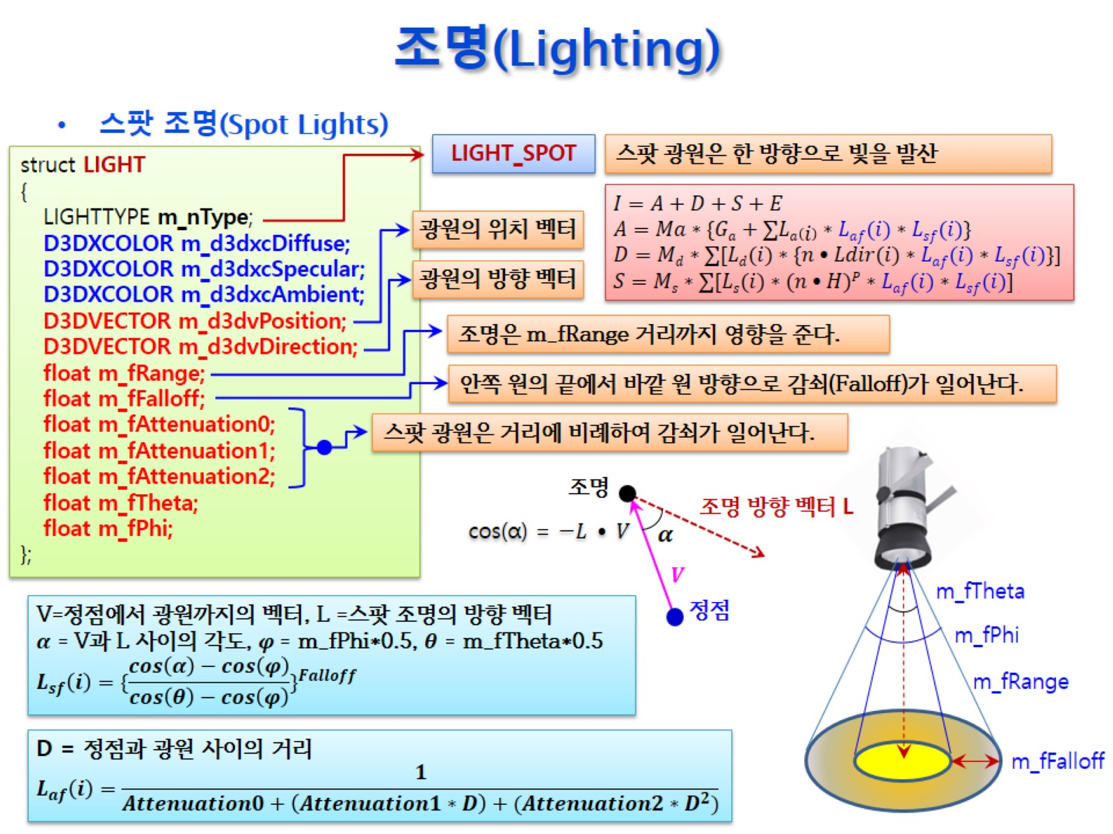
조명(Lighting)

Slide 8
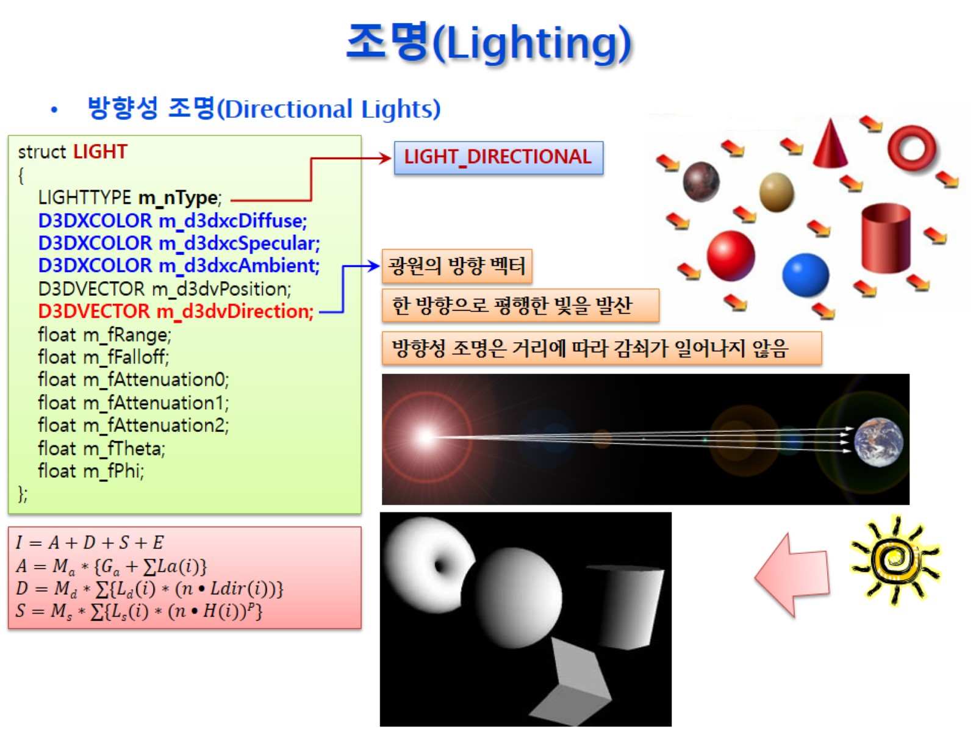
조명(Lighting)

Slide 9
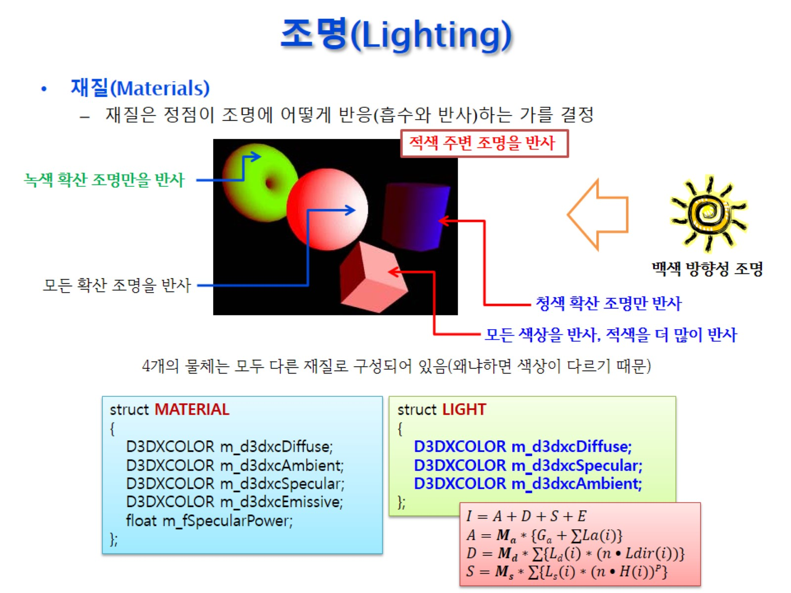
조명(Lighting)

Slide 10
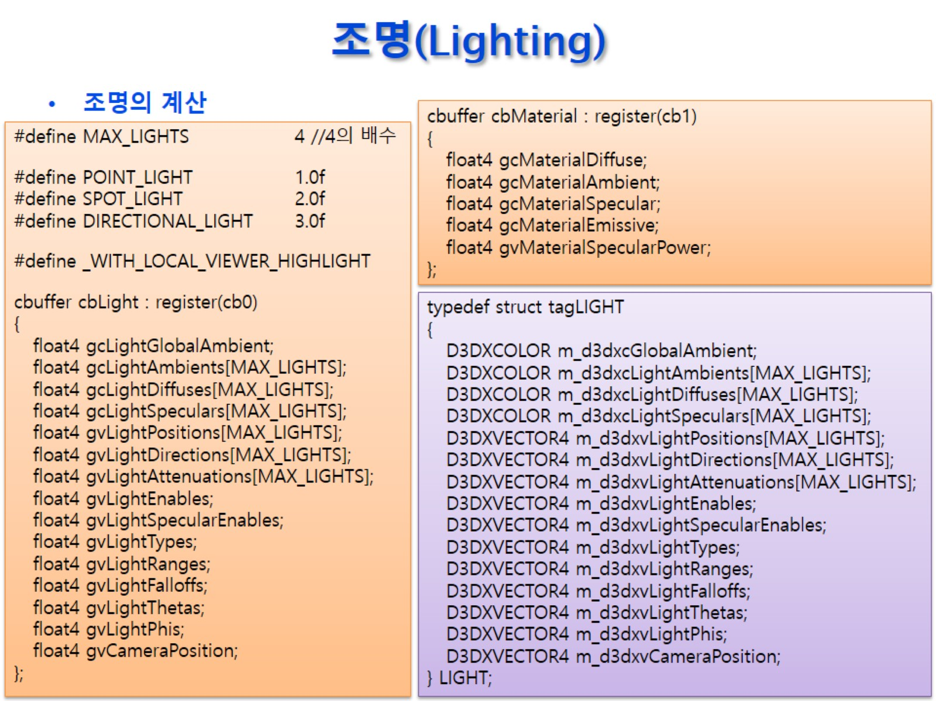
조명(Lighting)

Slide 11
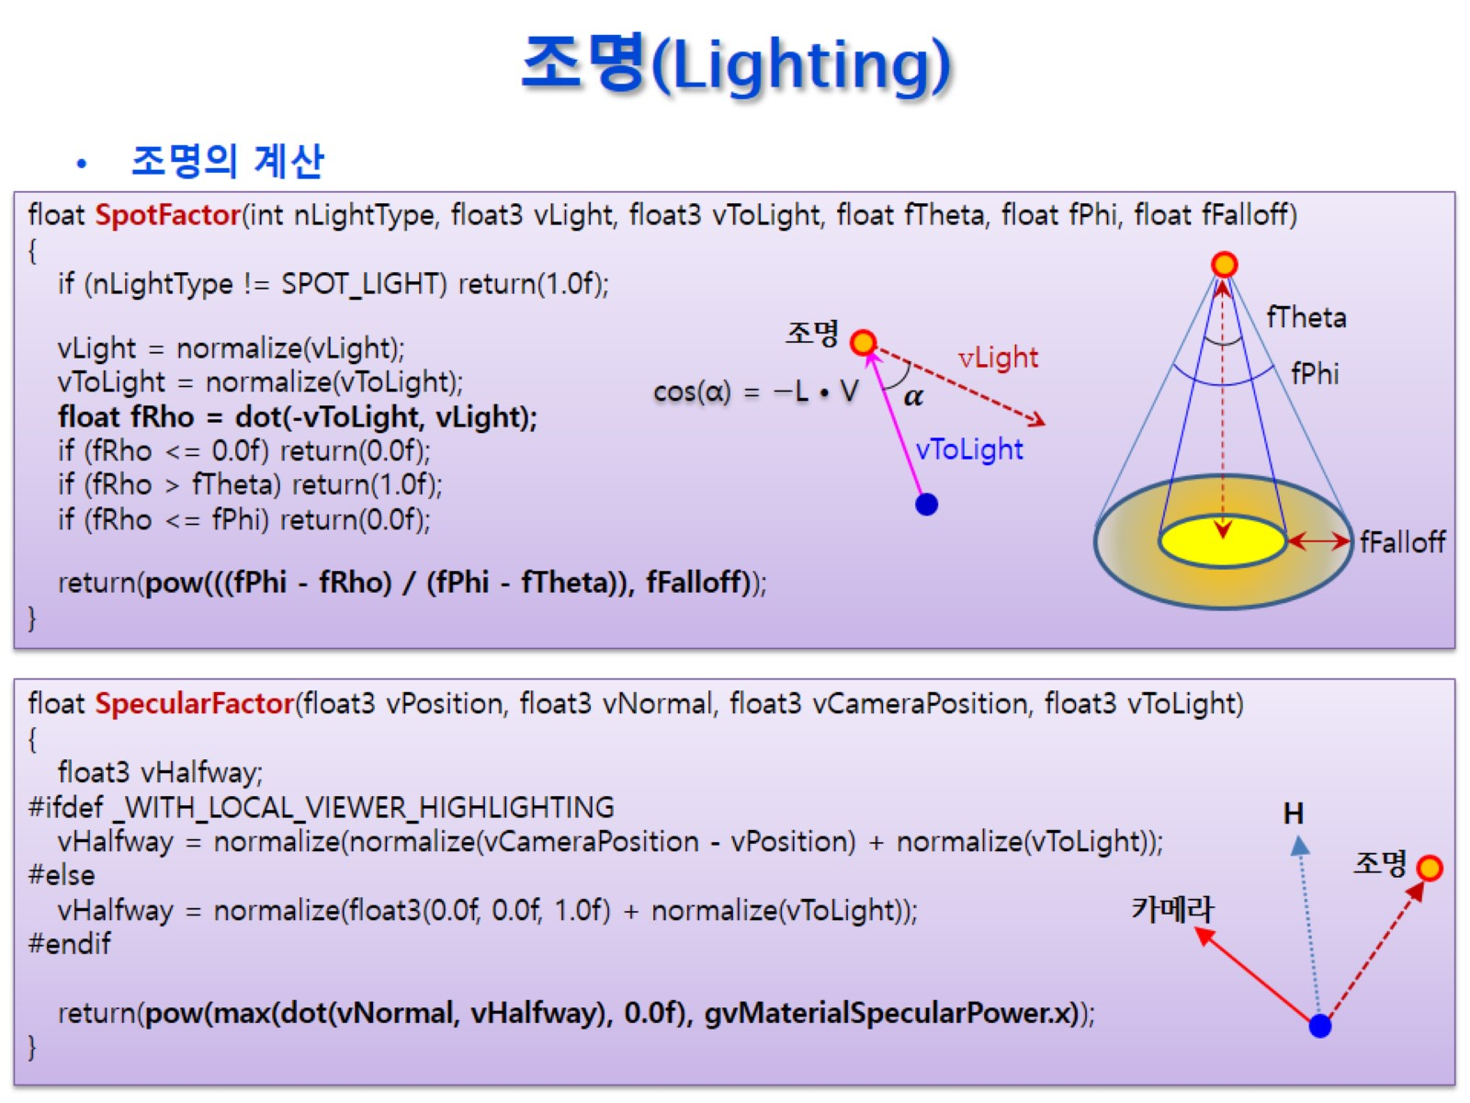
조명(Lighting)

Slide 12
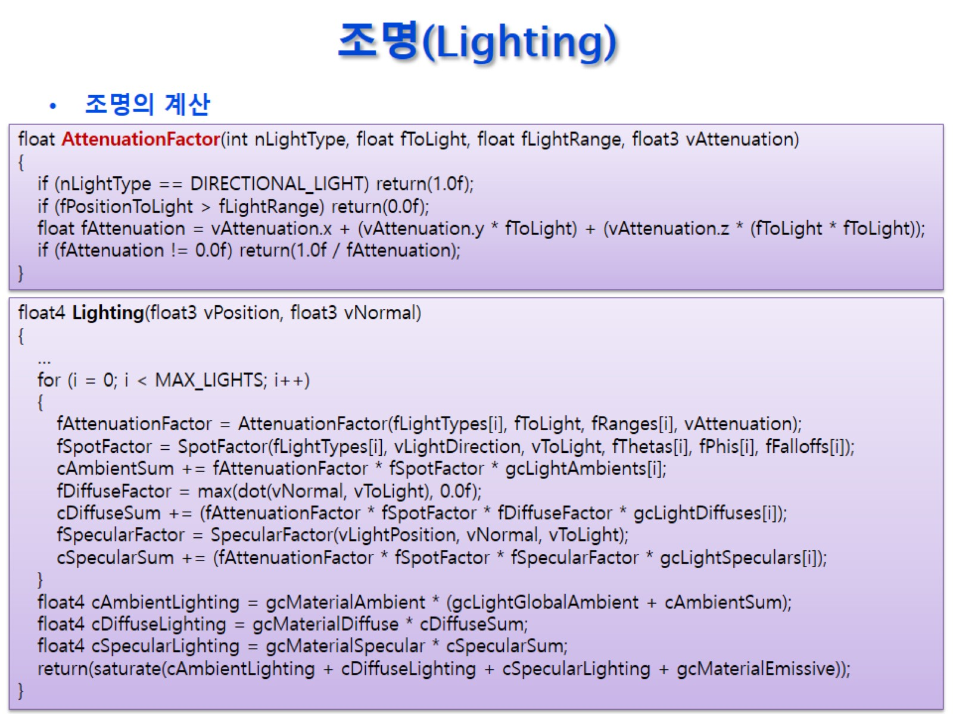
조명(Lighting)

Slide 13
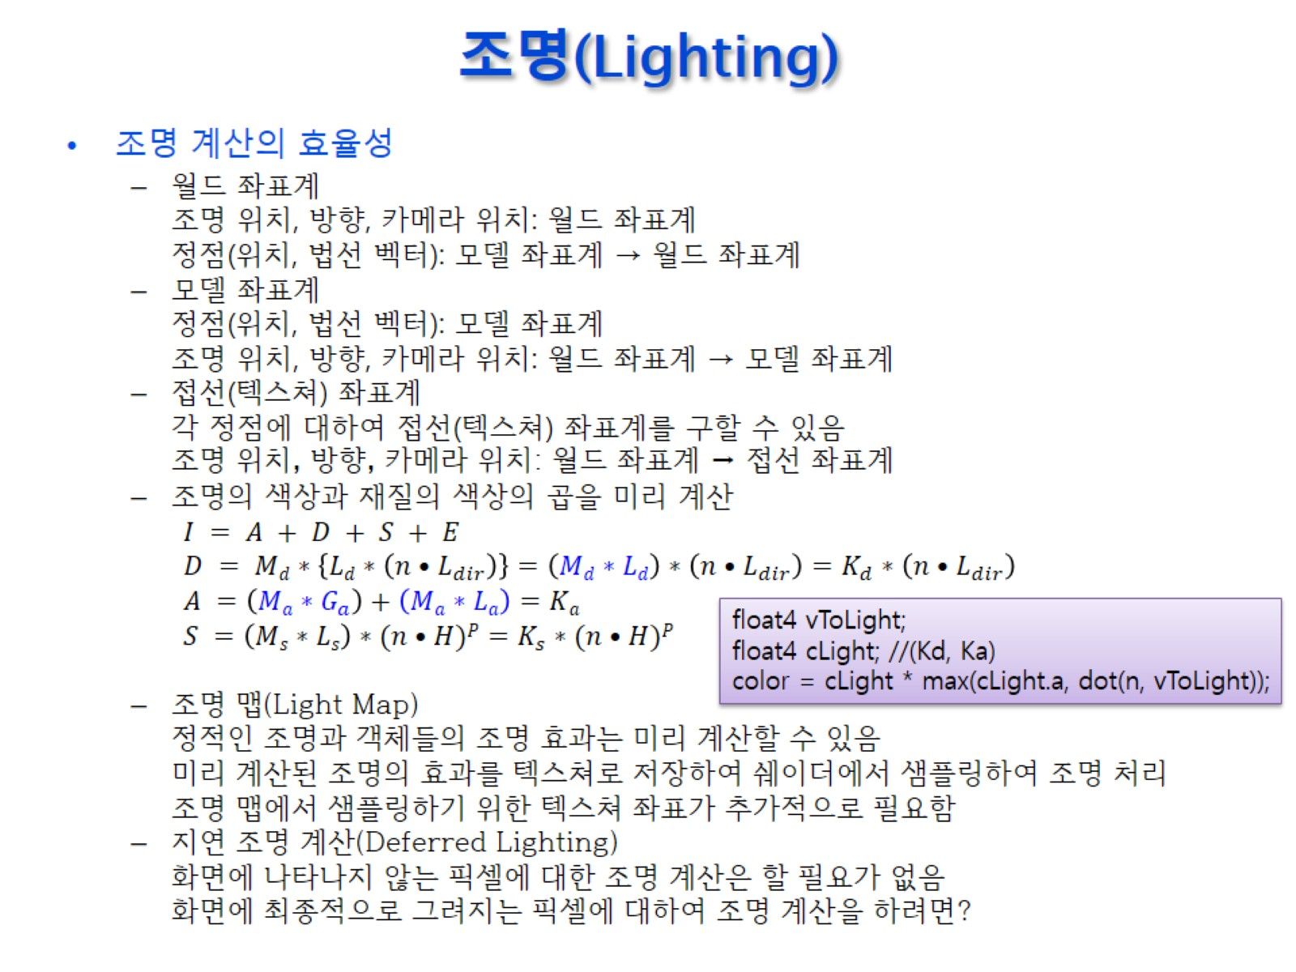
조명(Lighting)

Slide 14
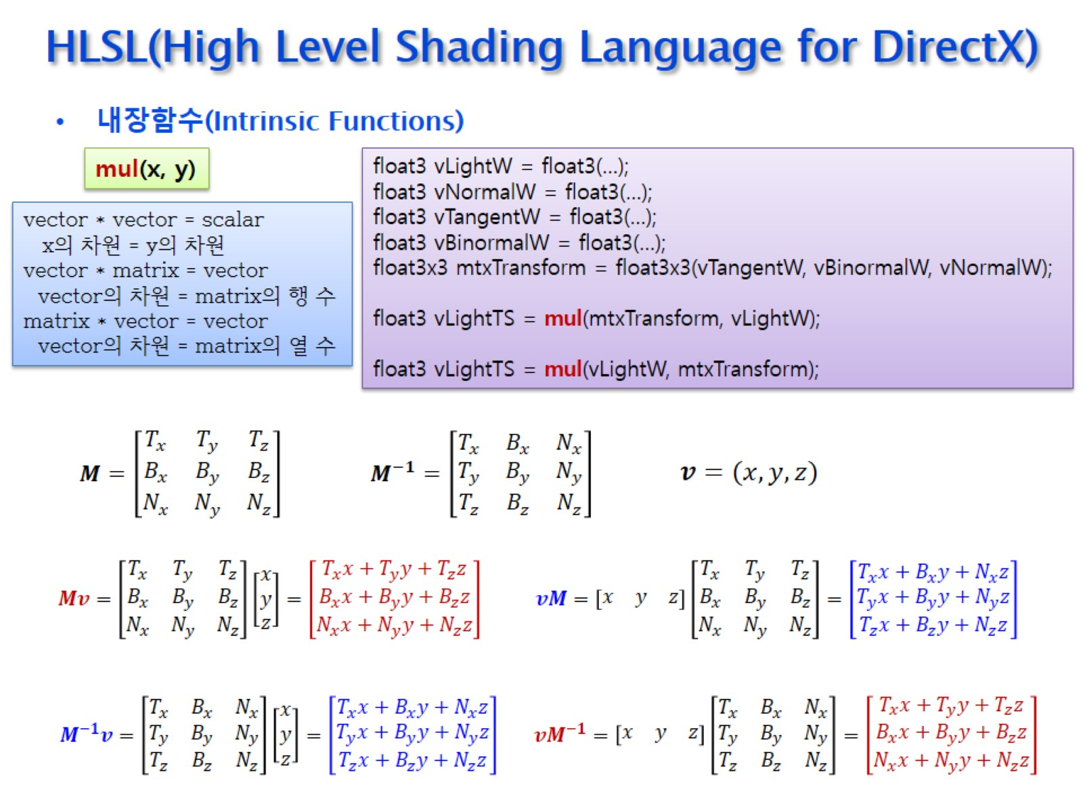
HLSL(High Level Shading Language for DirectX)

Slide 15
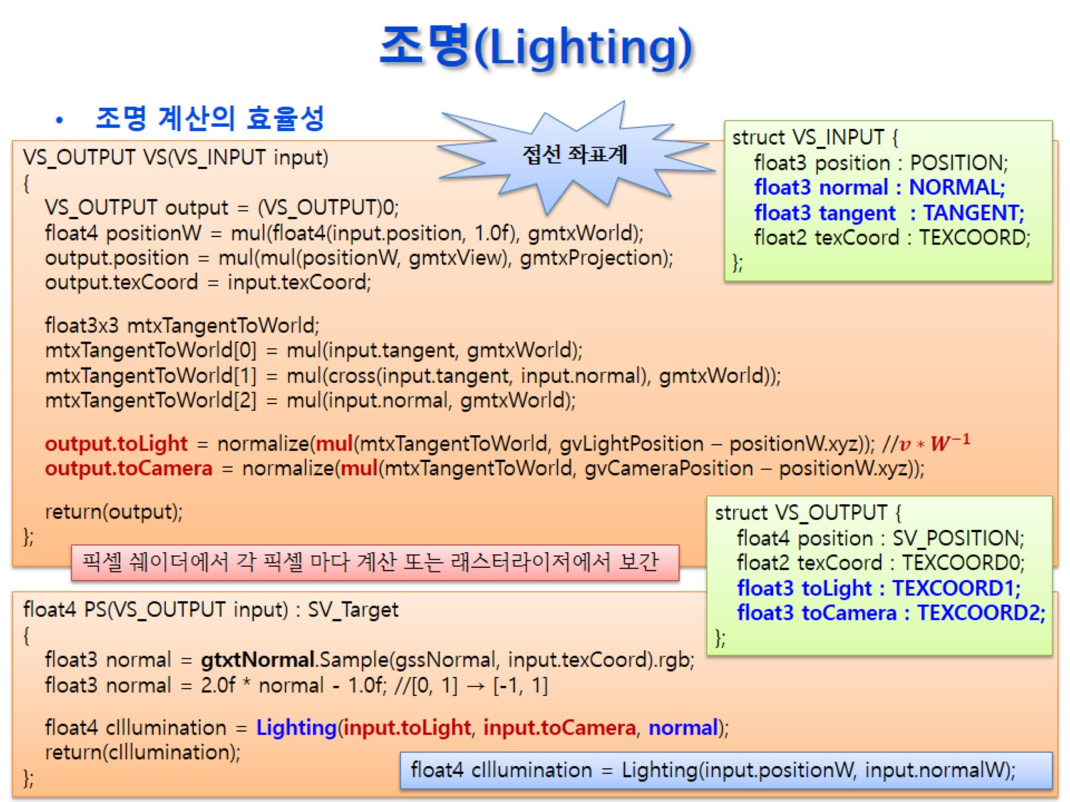
조명(Lighting)

Slide 16
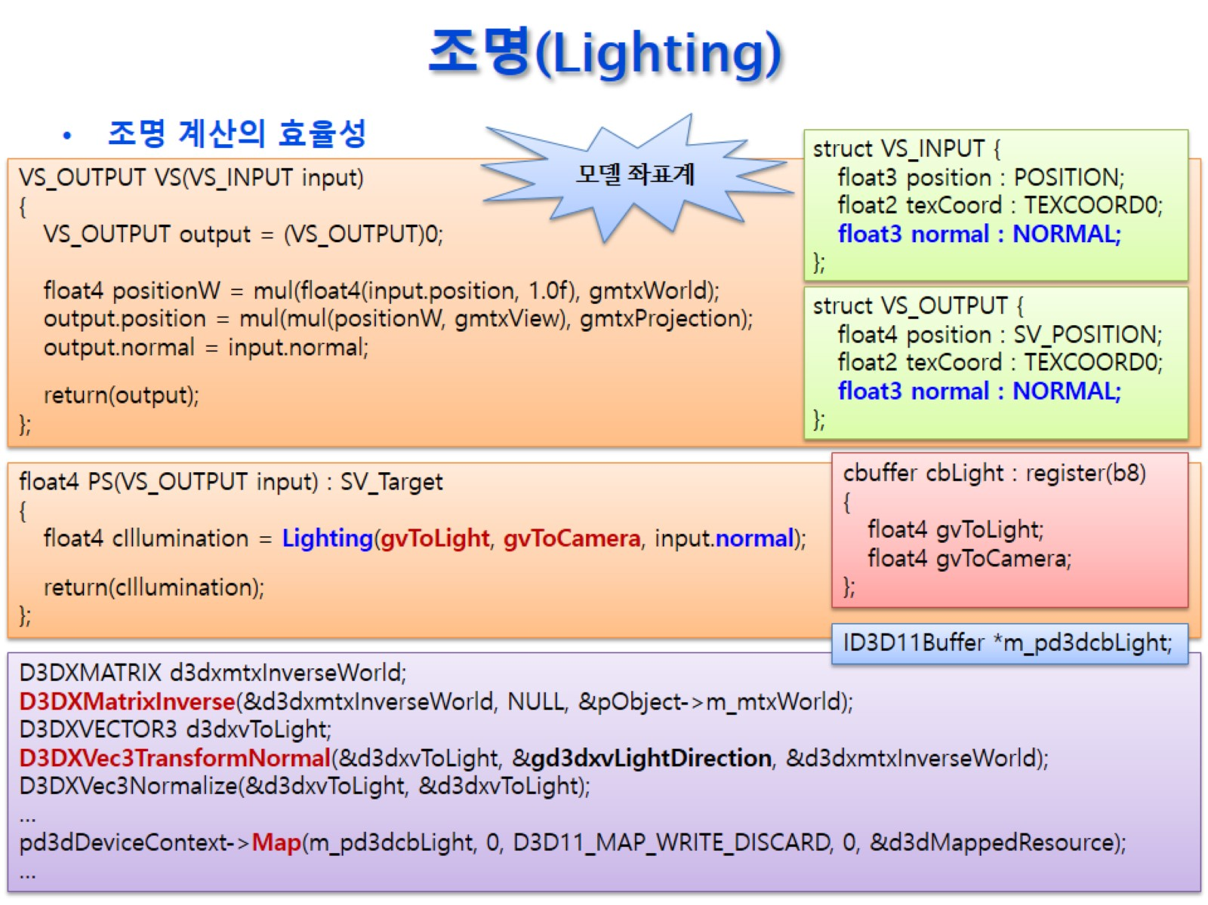
조명(Lighting)

Slide 17
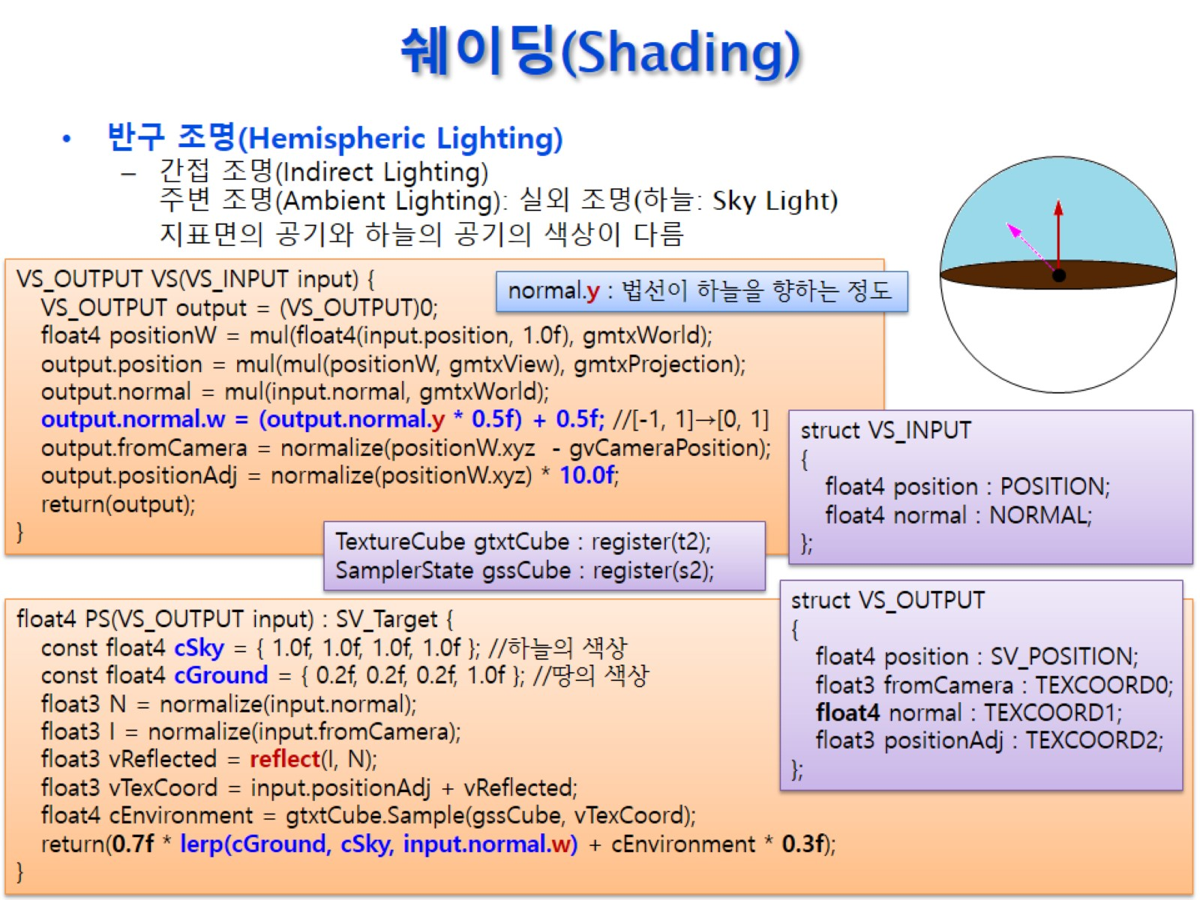
쉐이딩(Shading)

Slide 18
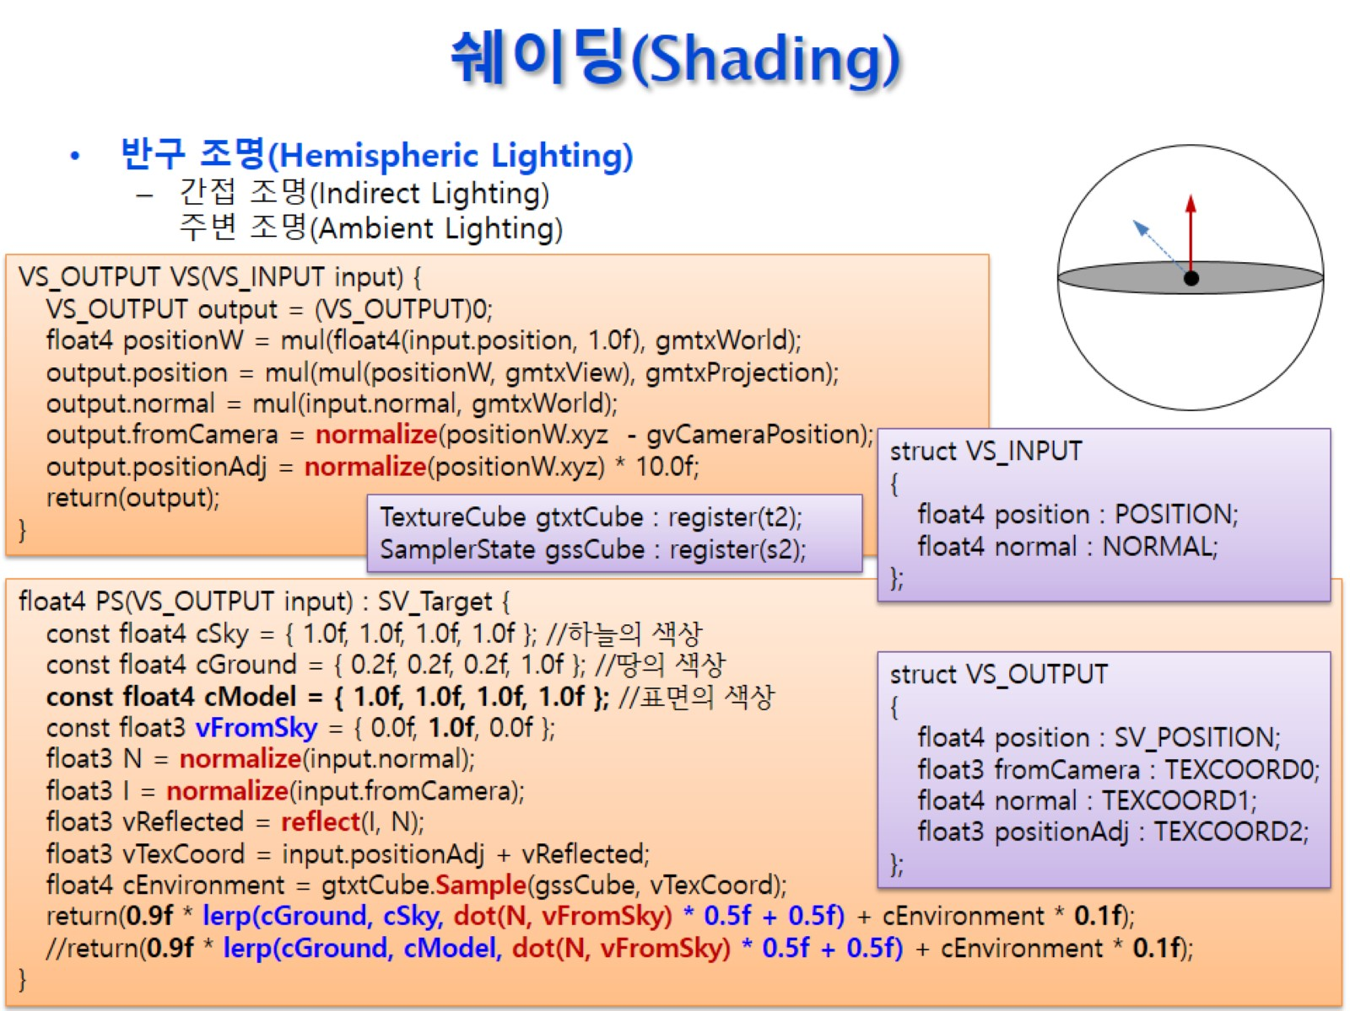
쉐이딩(Shading)

Slide 19
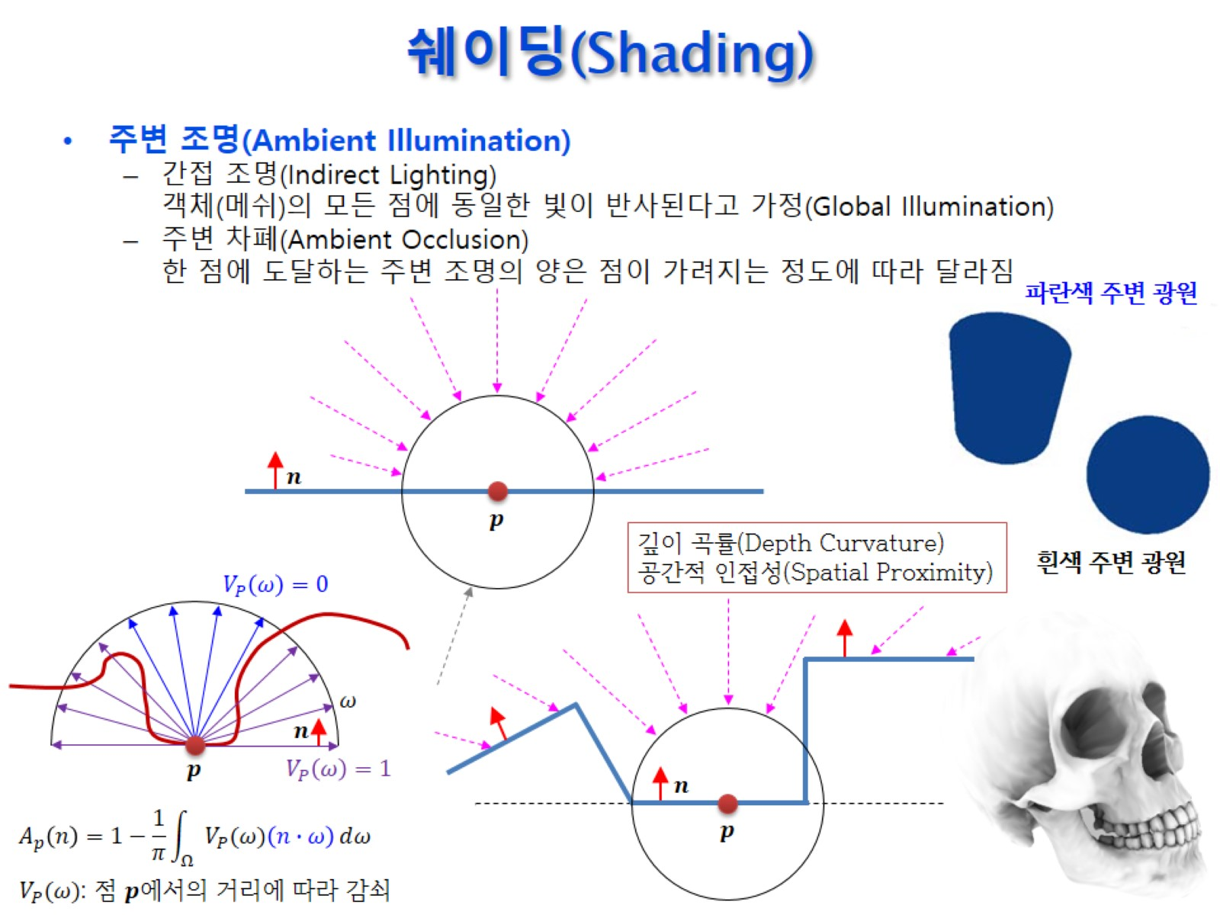
쉐이딩(Shading)

Slide 20
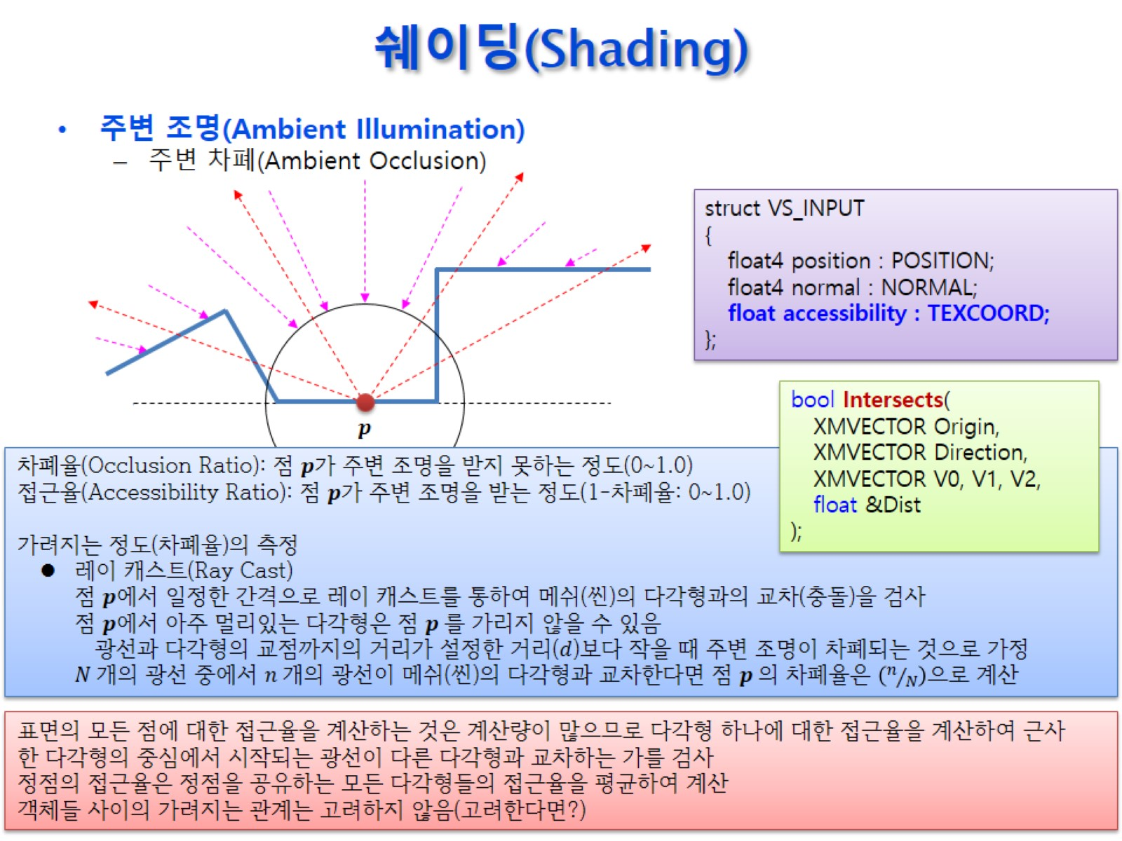
쉐이딩(Shading)

Slide 21
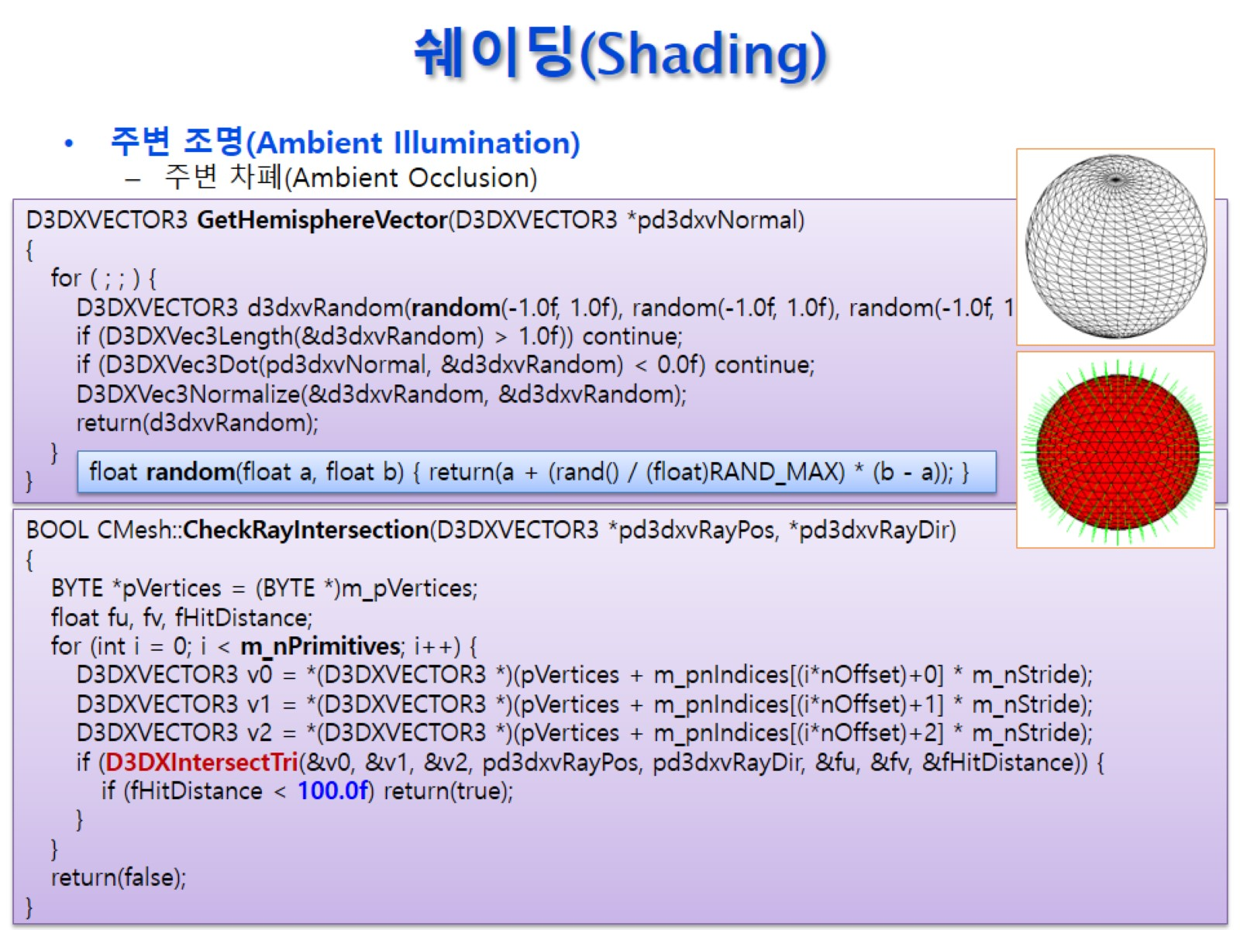
쉐이딩(Shading)

Slide 22
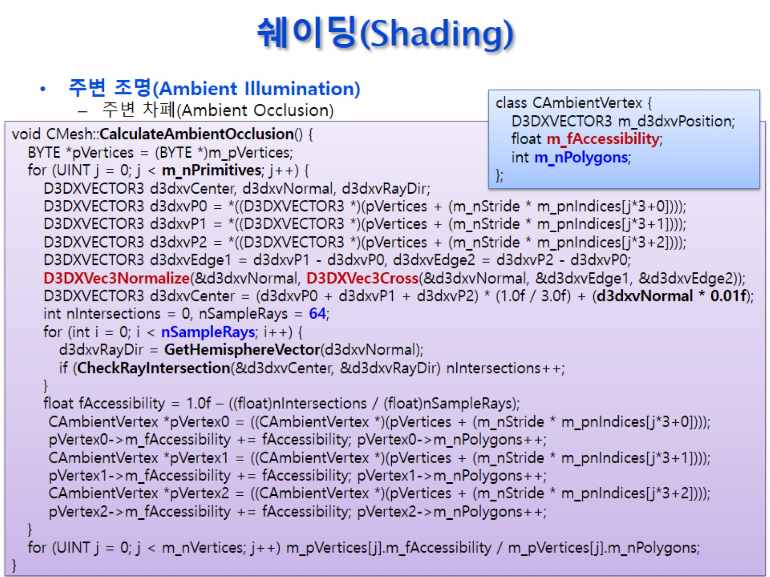
쉐이딩(Shading)

Slide 23
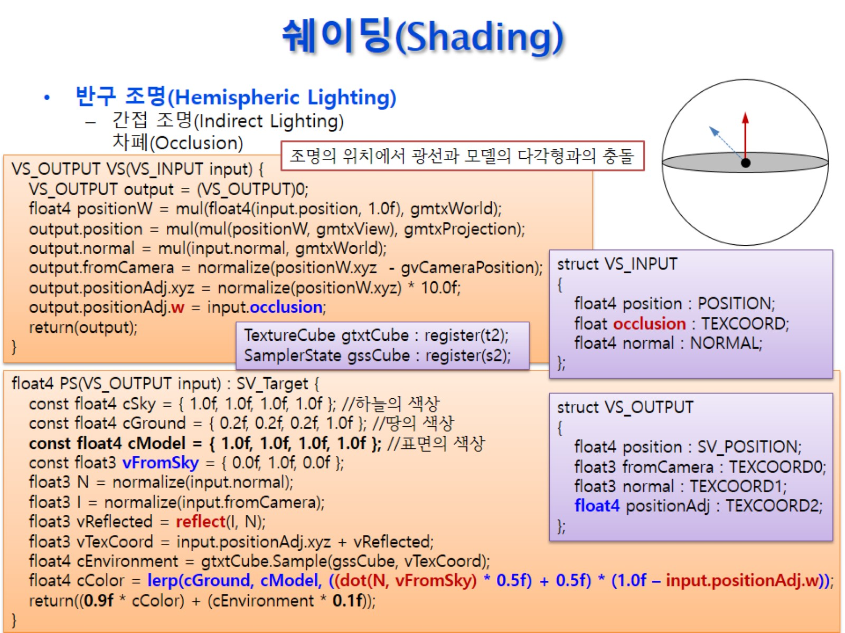
쉐이딩(Shading)

Slide 24
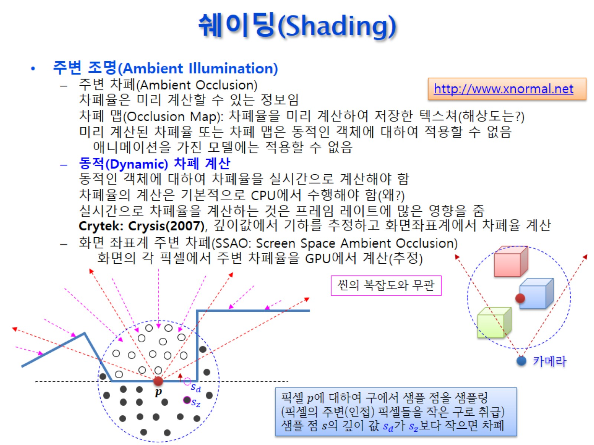
쉐이딩(Shading)

Slide 25
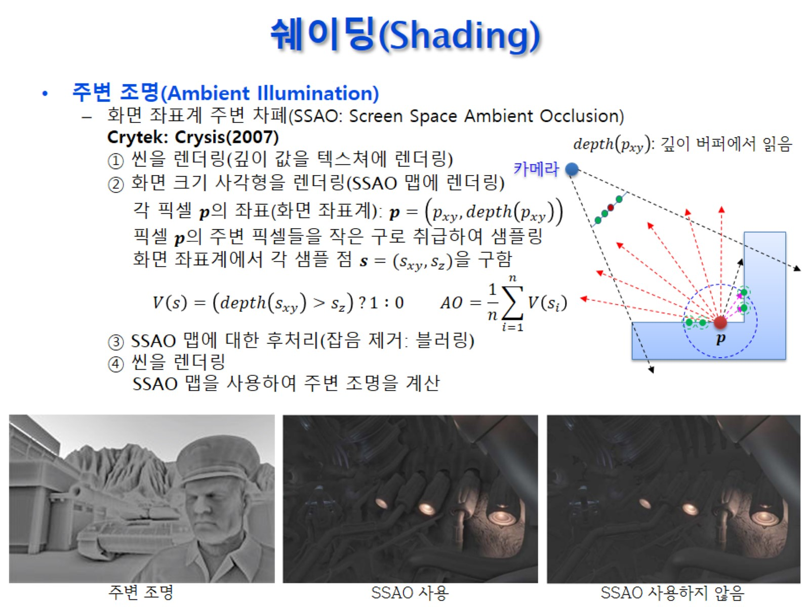
쉐이딩(Shading)

Slide 26
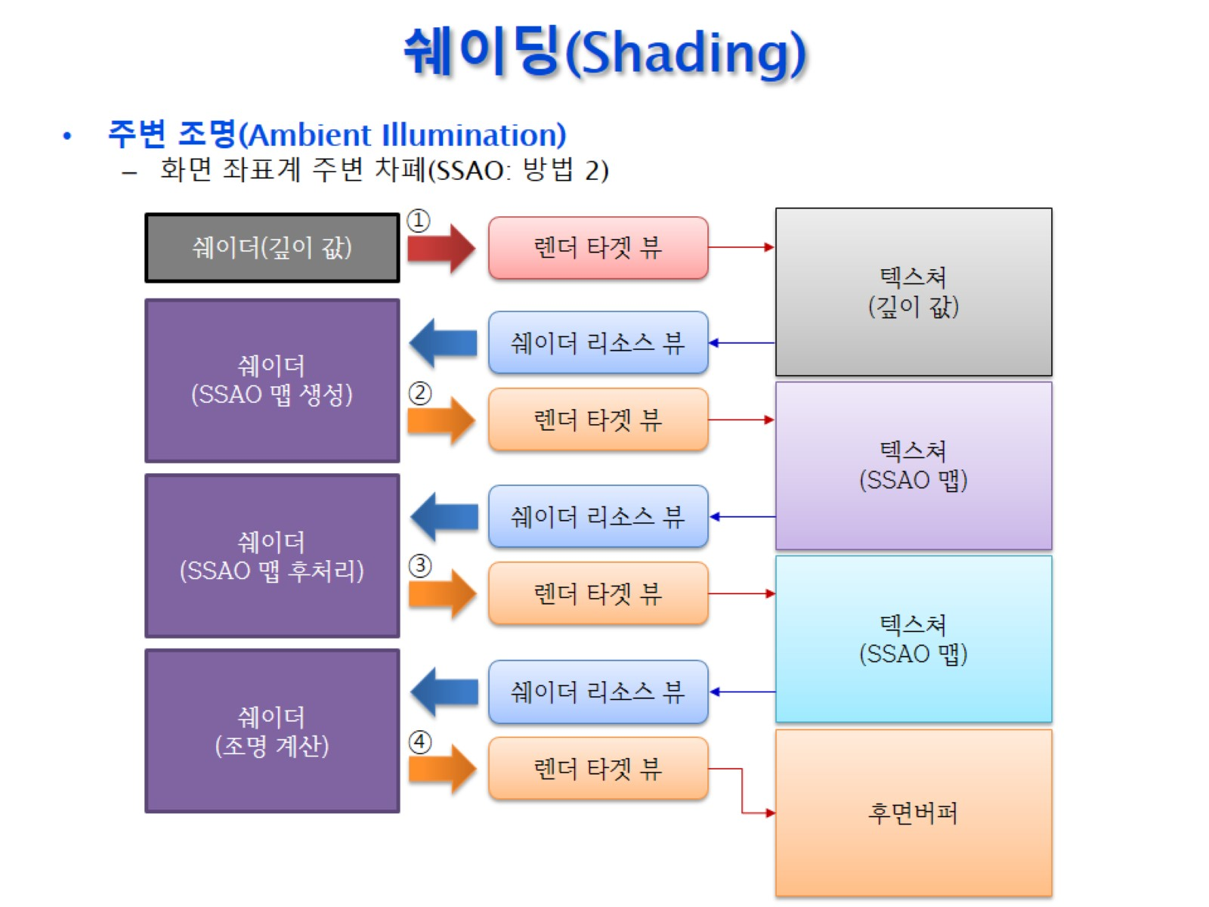
쉐이딩(Shading)

Slide 27
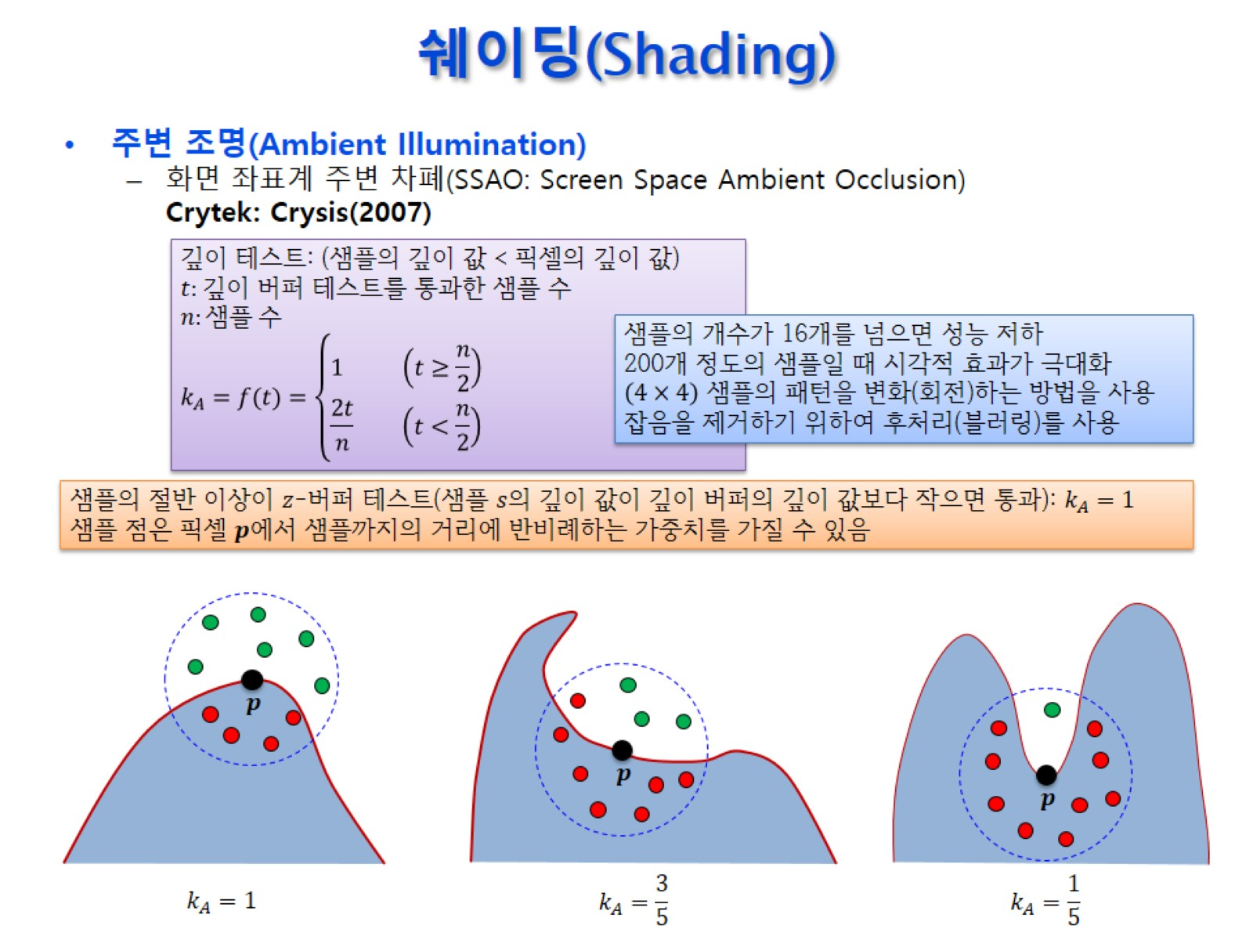
쉐이딩(Shading)

Slide 28
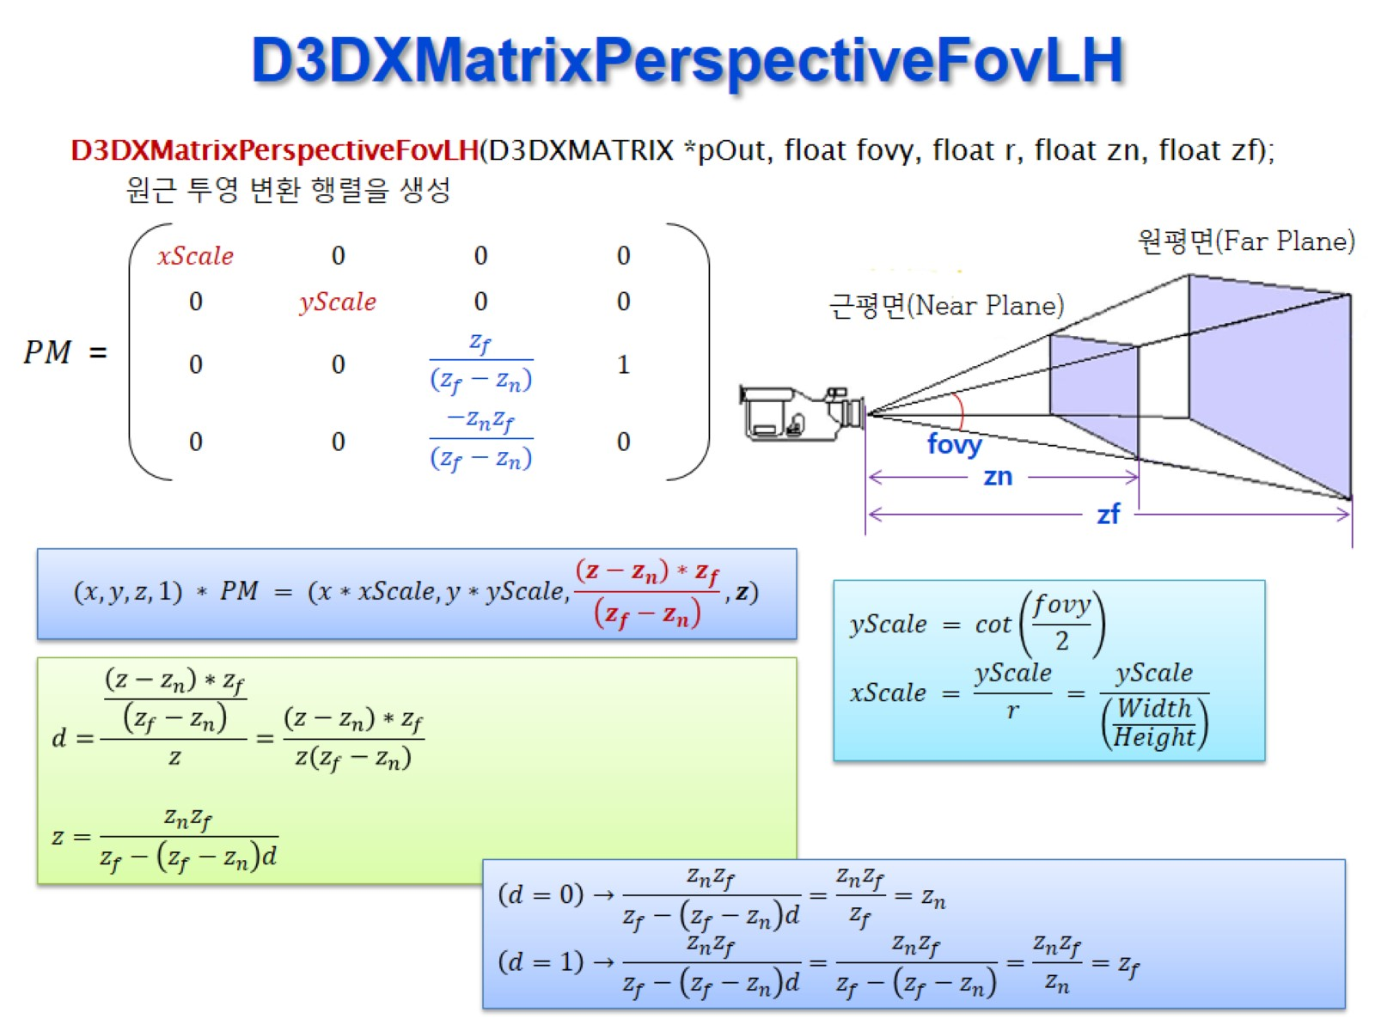
D3DXMatrixPerspectiveFovLH

Slide 29
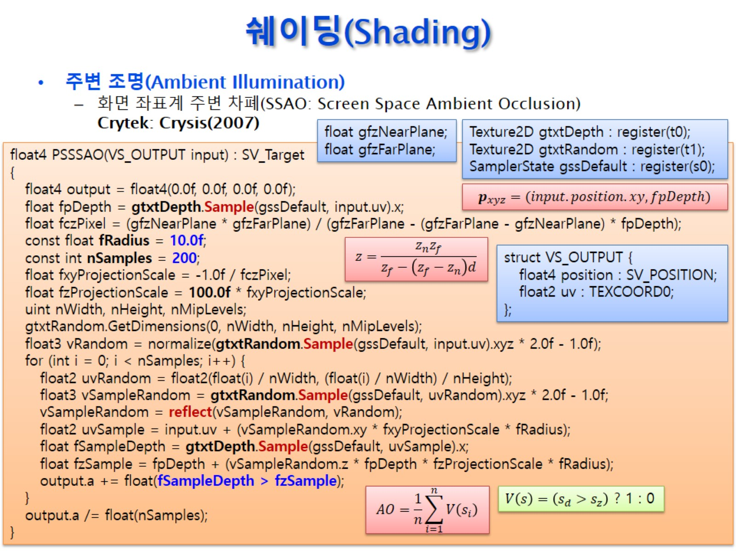
쉐이딩(Shading)

Slide 30
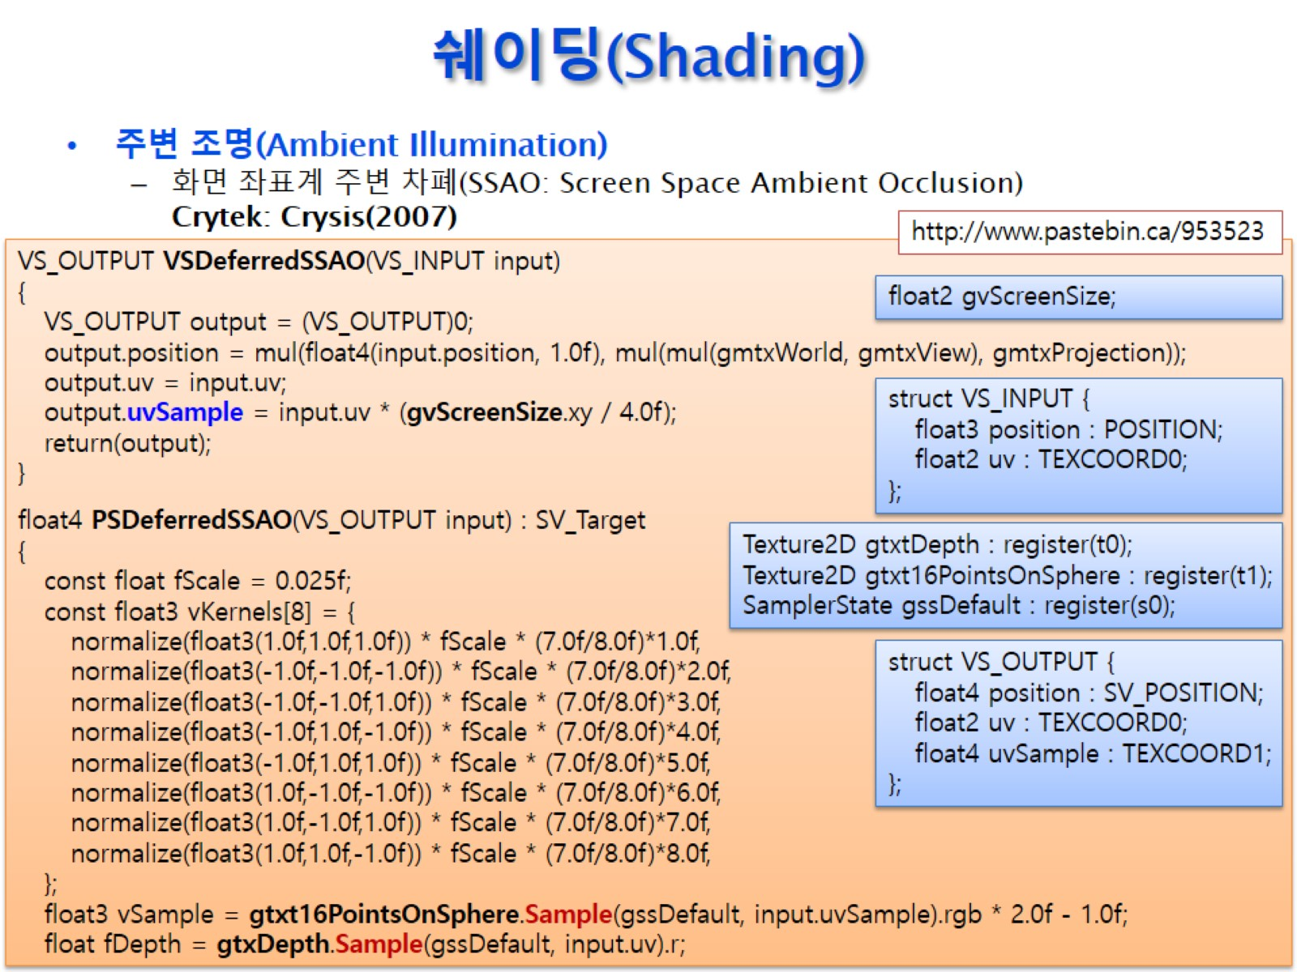
쉐이딩(Shading)

Slide 31
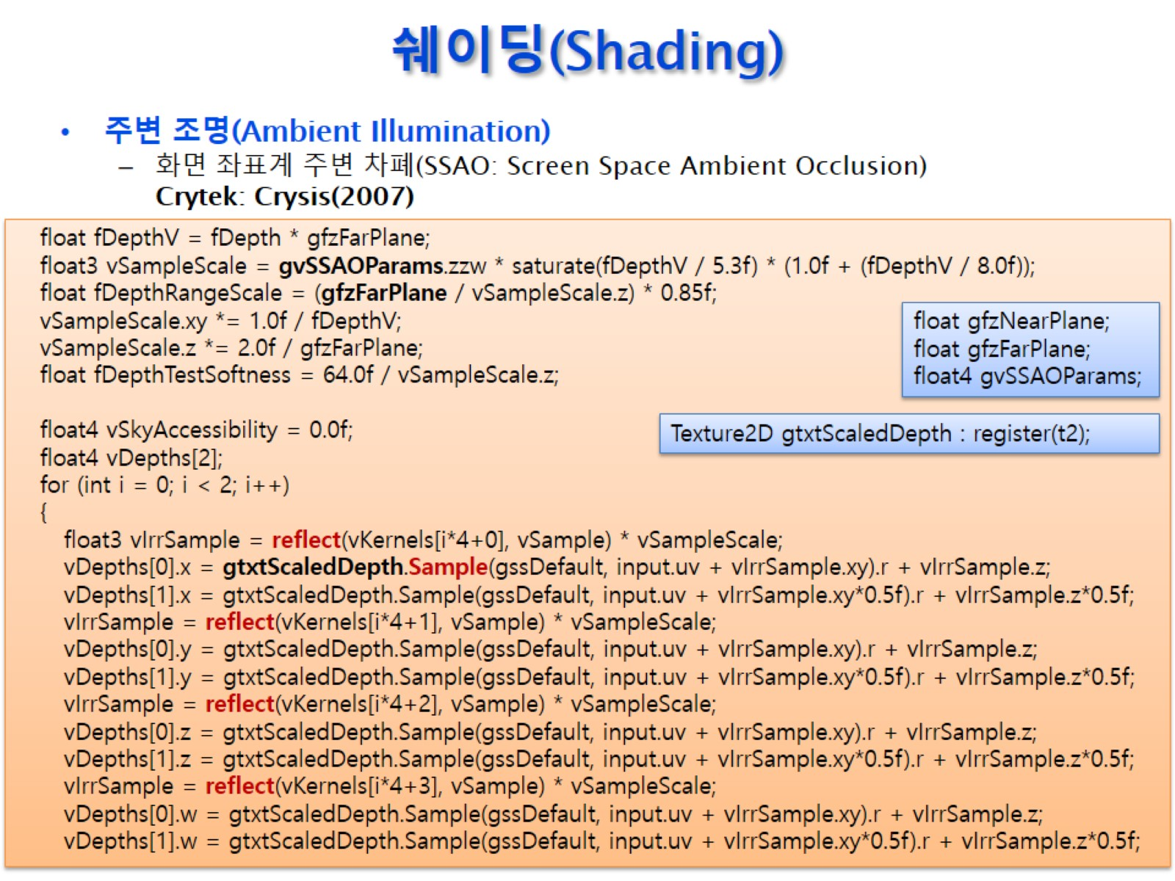
쉐이딩(Shading)

Slide 32
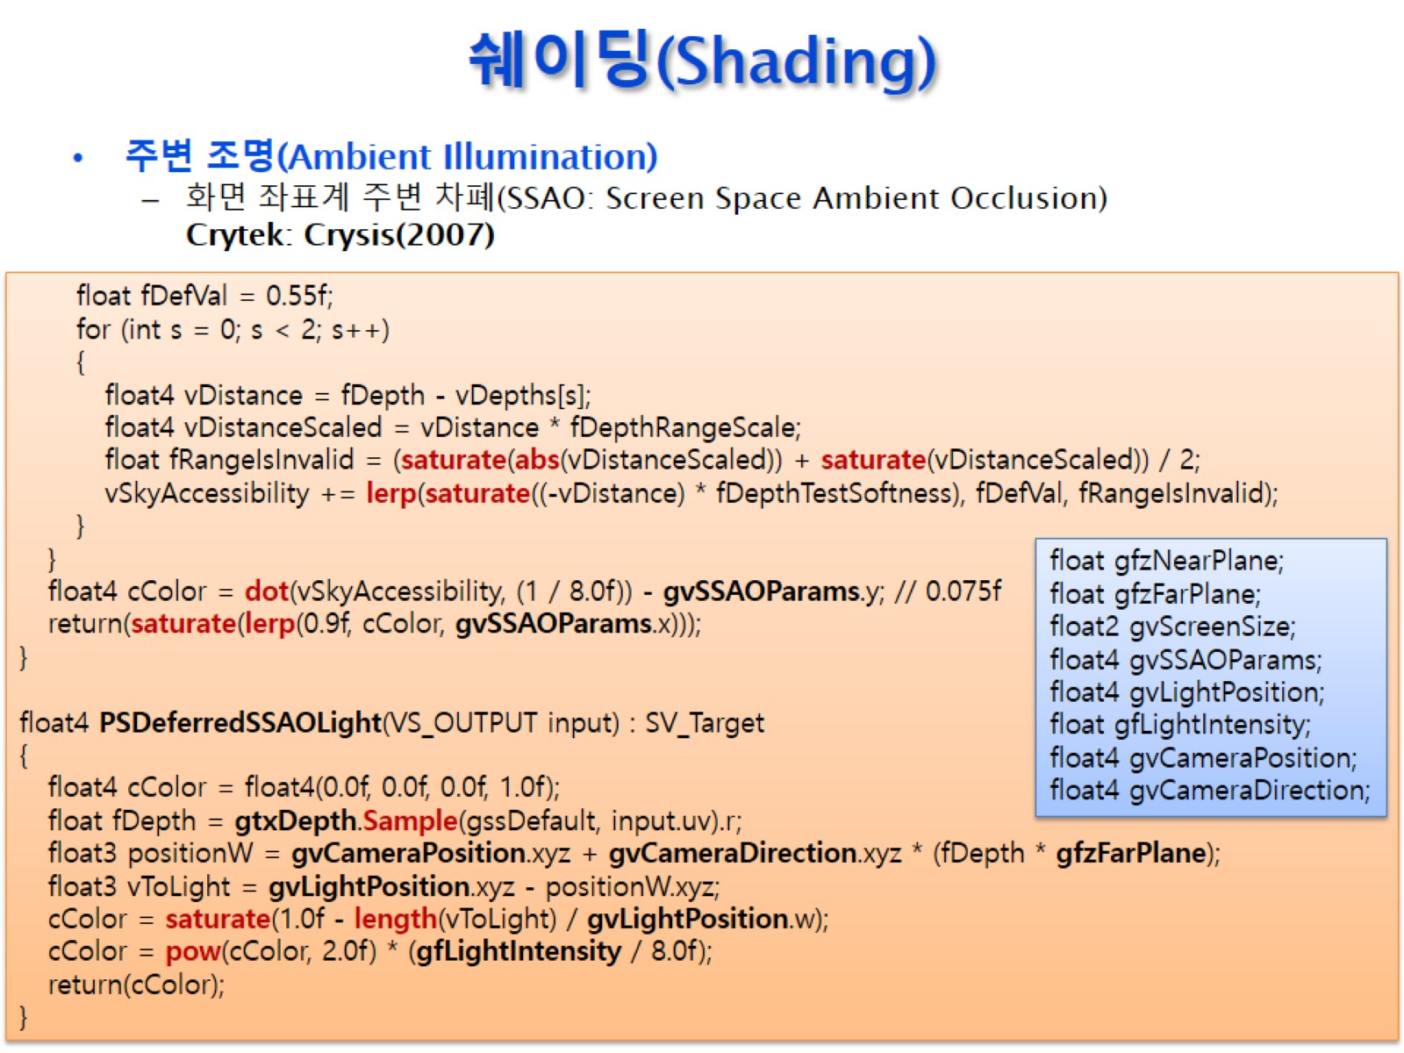
쉐이딩(Shading)

Slide 33
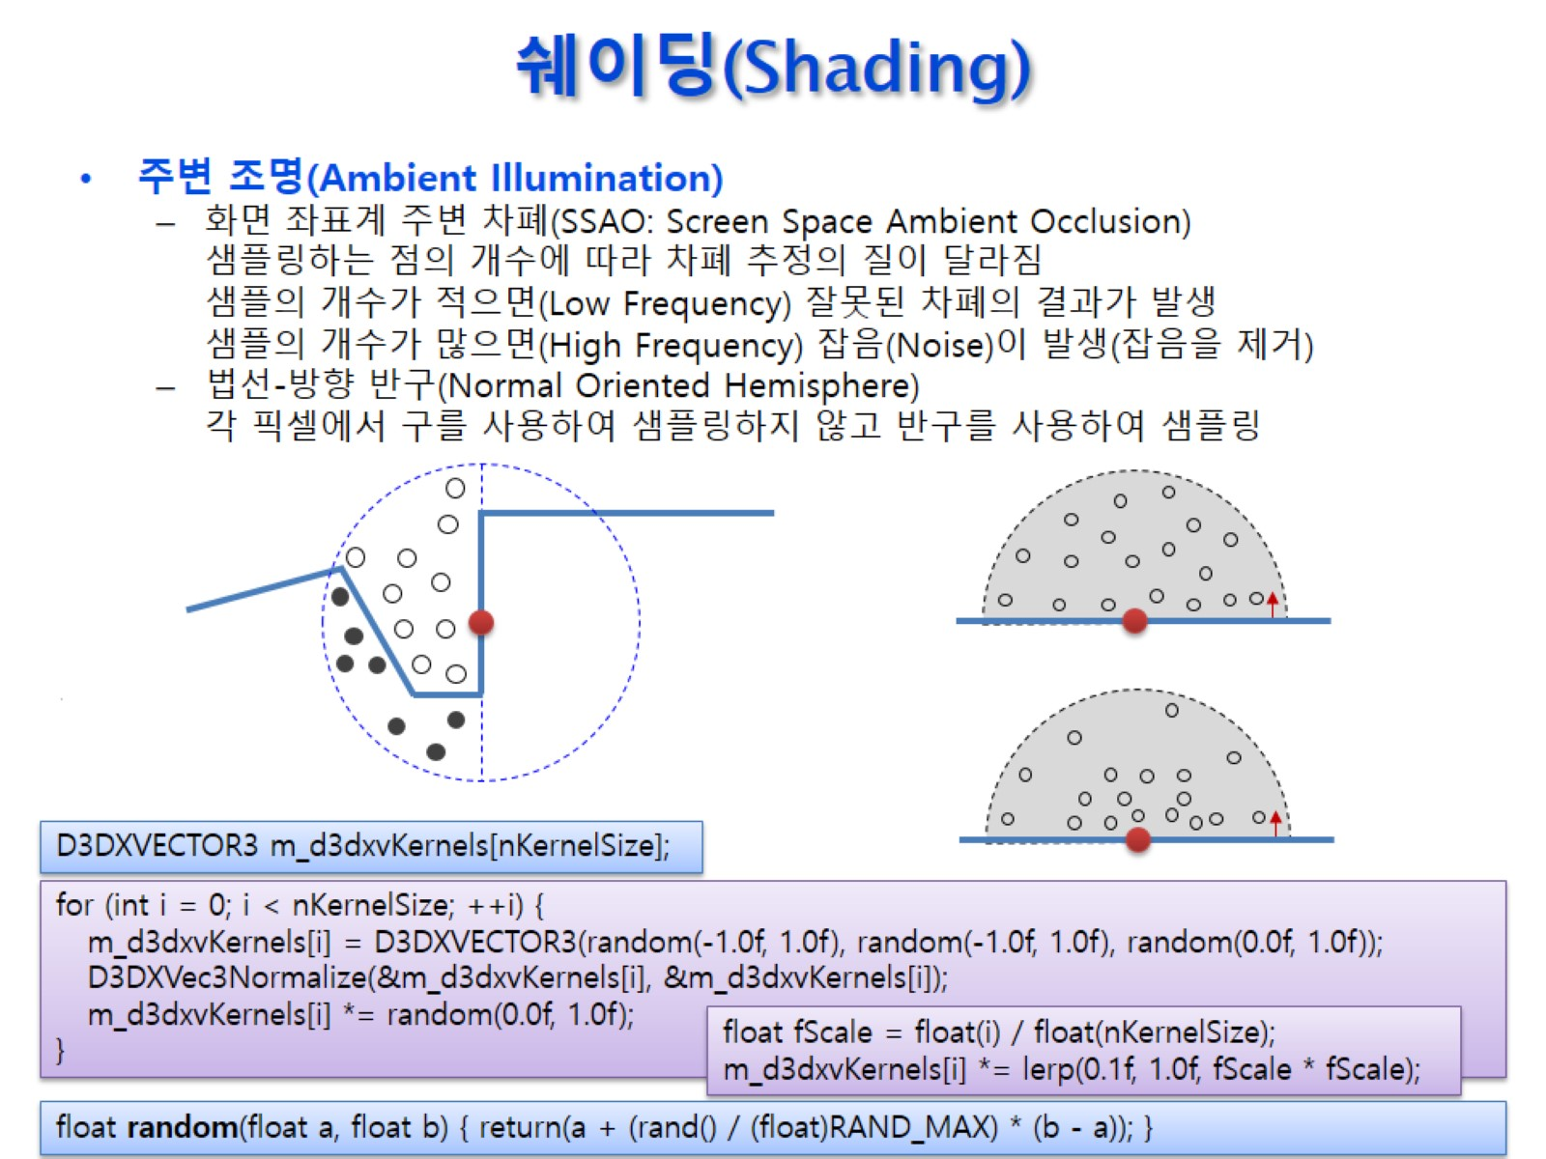
쉐이딩(Shading)

Slide 34
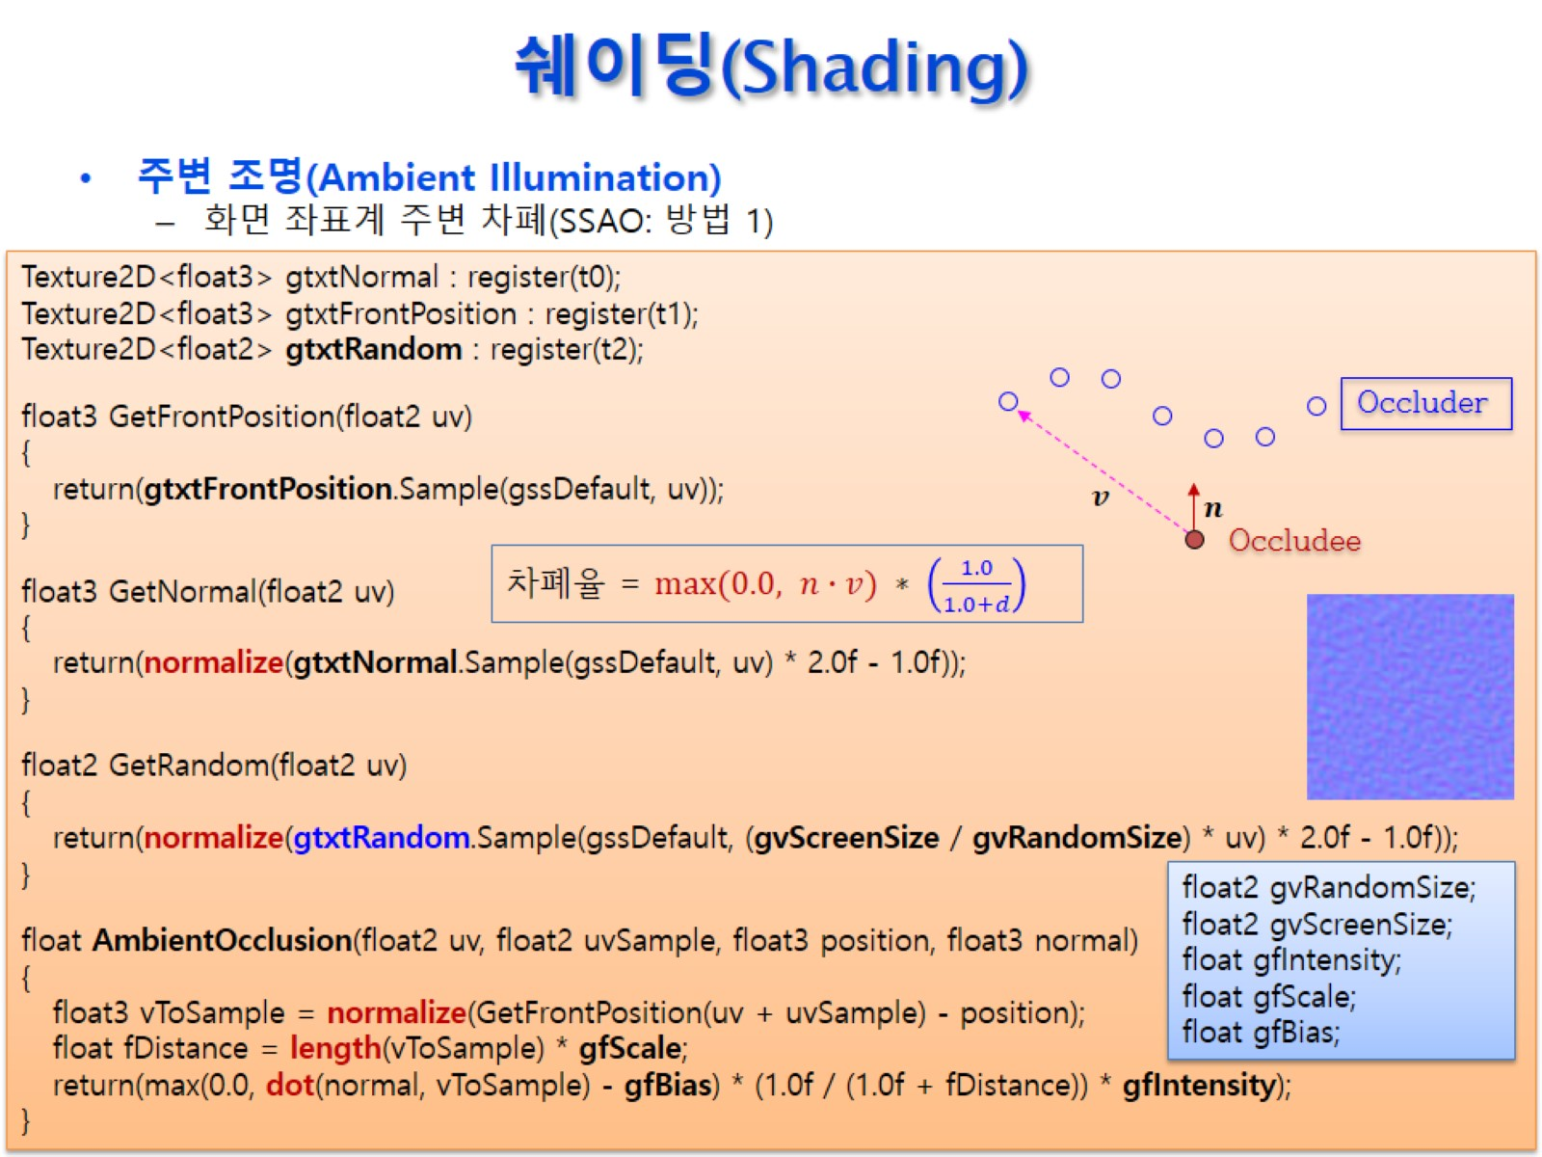
쉐이딩(Shading)

Slide 35
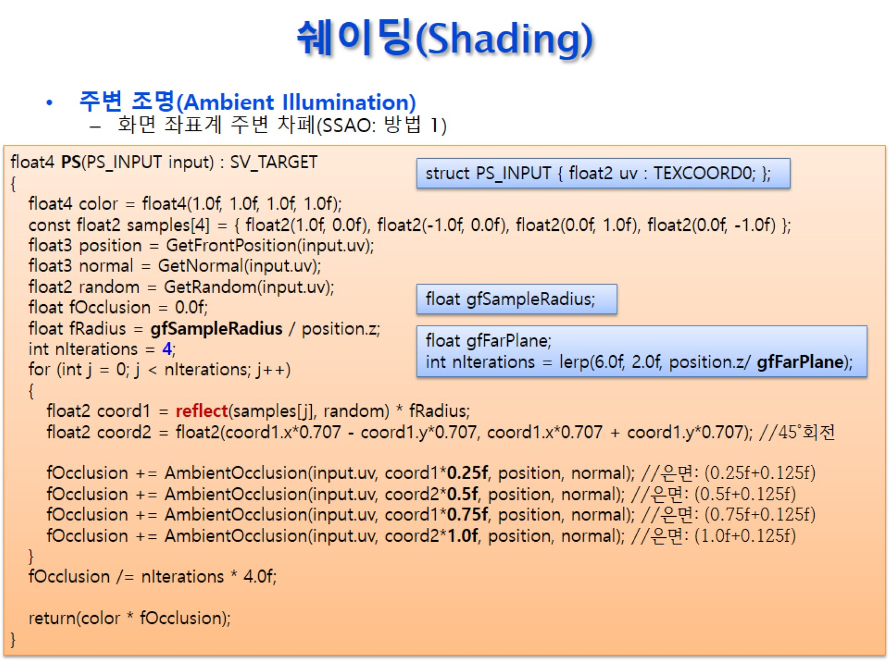
쉐이딩(Shading)

Slide 36
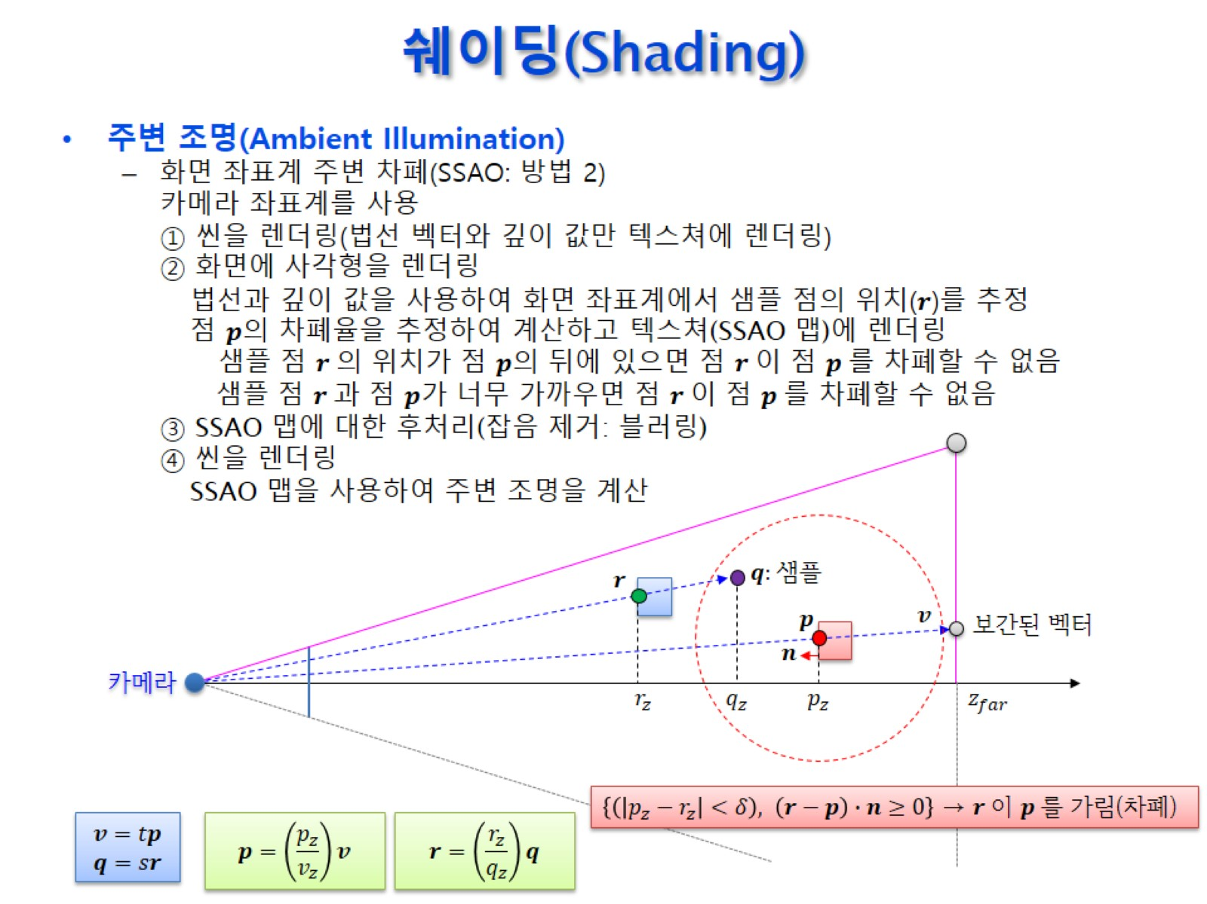
쉐이딩(Shading)

Slide 37

쉐이딩(Shading)

Slide 38
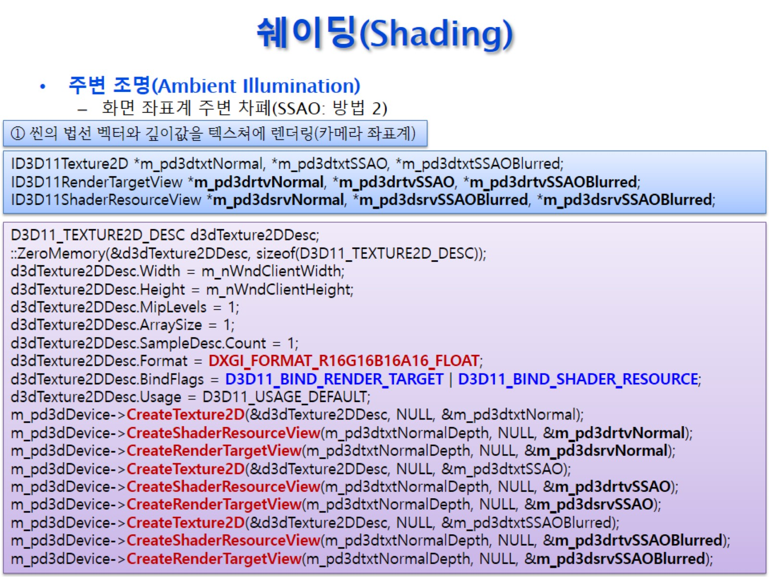
쉐이딩(Shading)

Slide 39
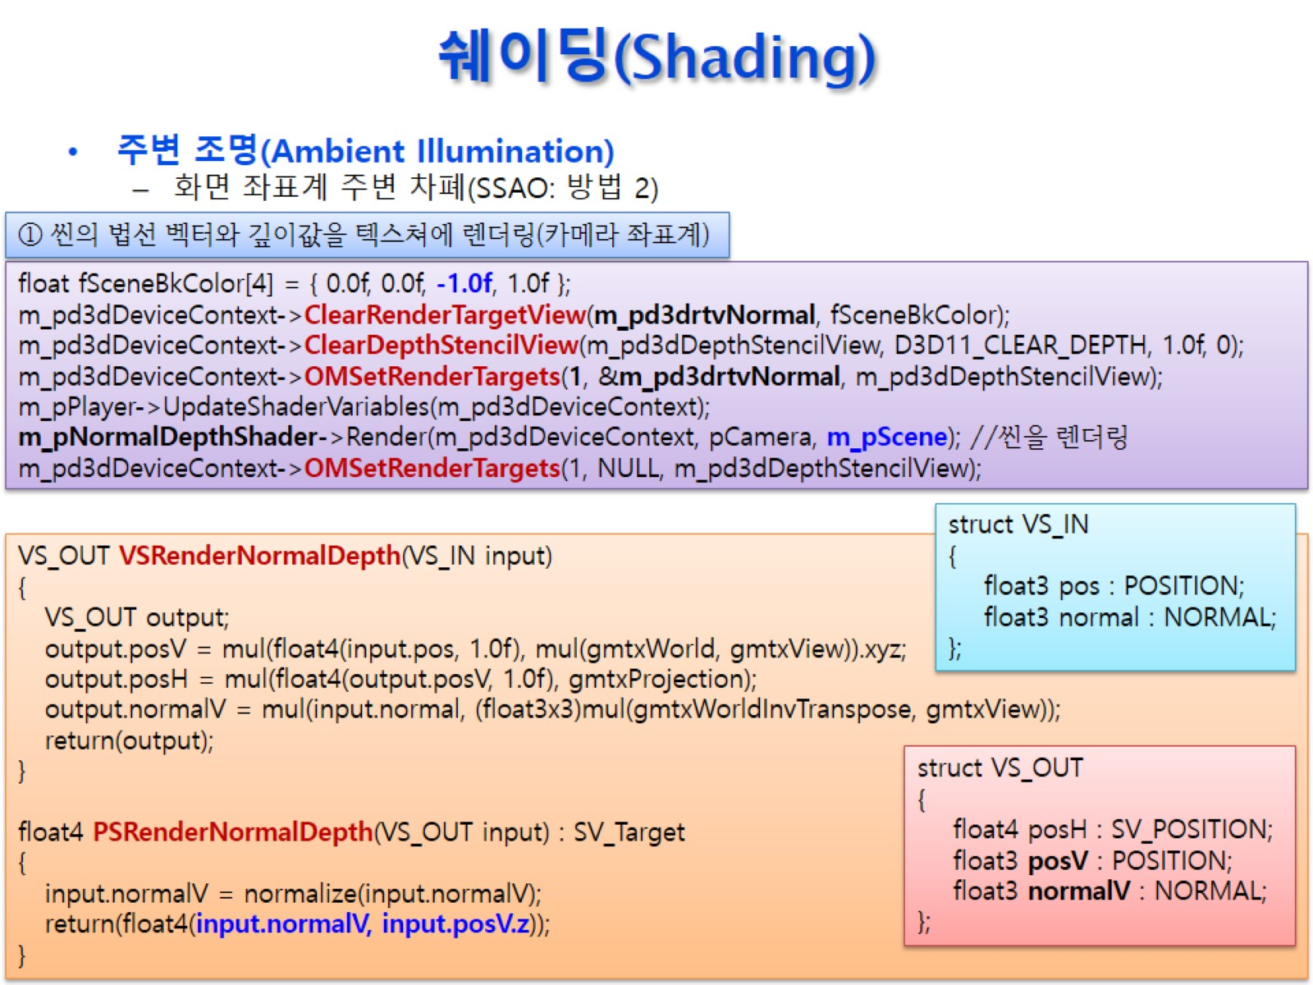
쉐이딩(Shading)

Slide 40
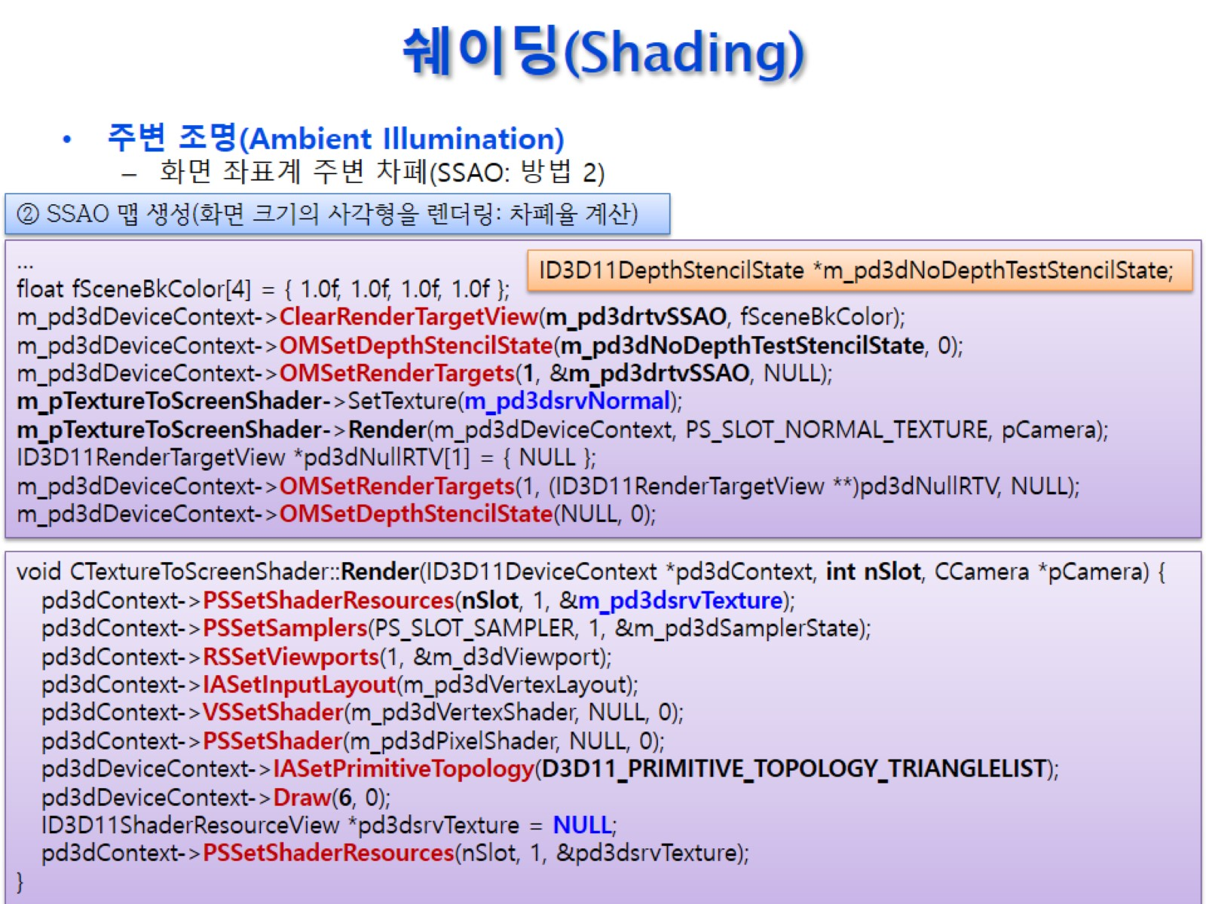
쉐이딩(Shading)

Slide 41
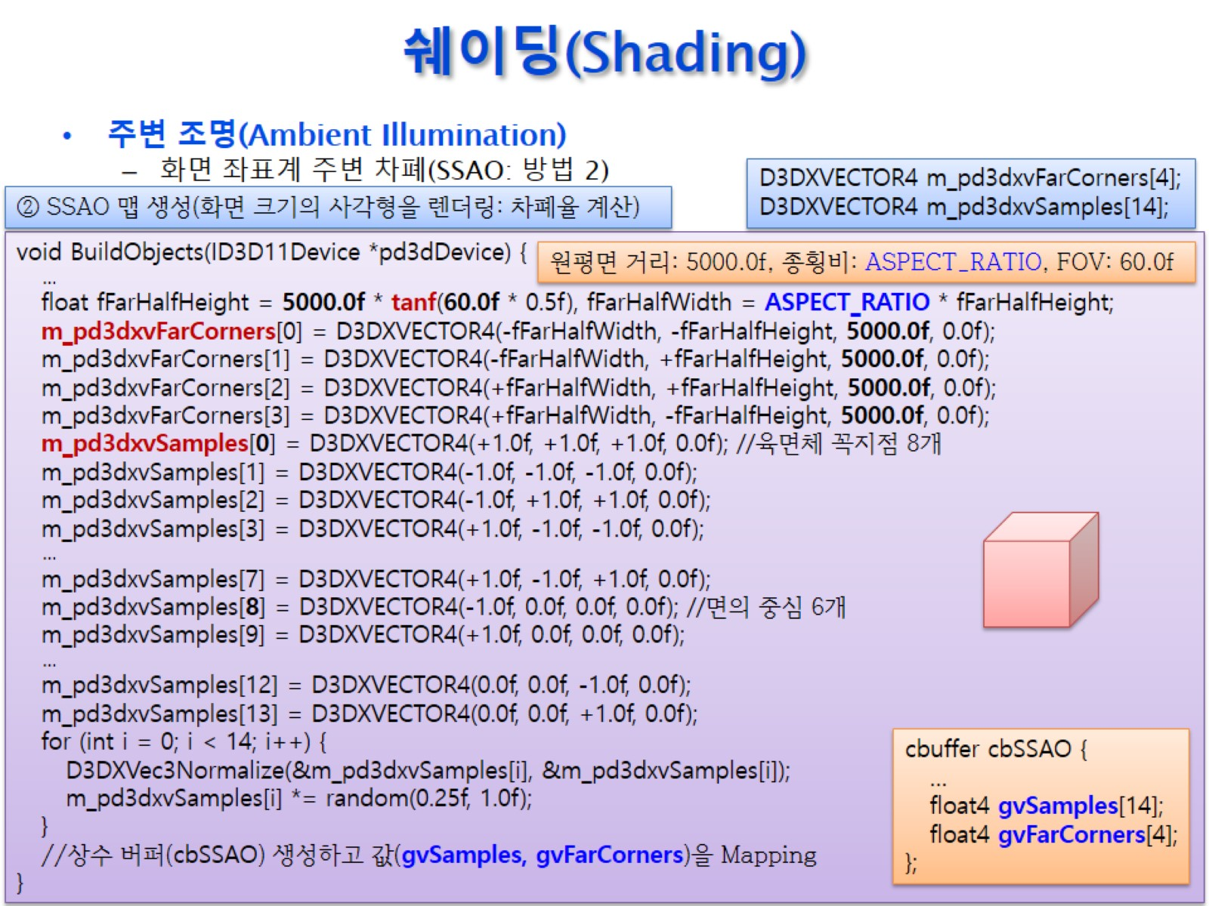
쉐이딩(Shading)

Slide 42
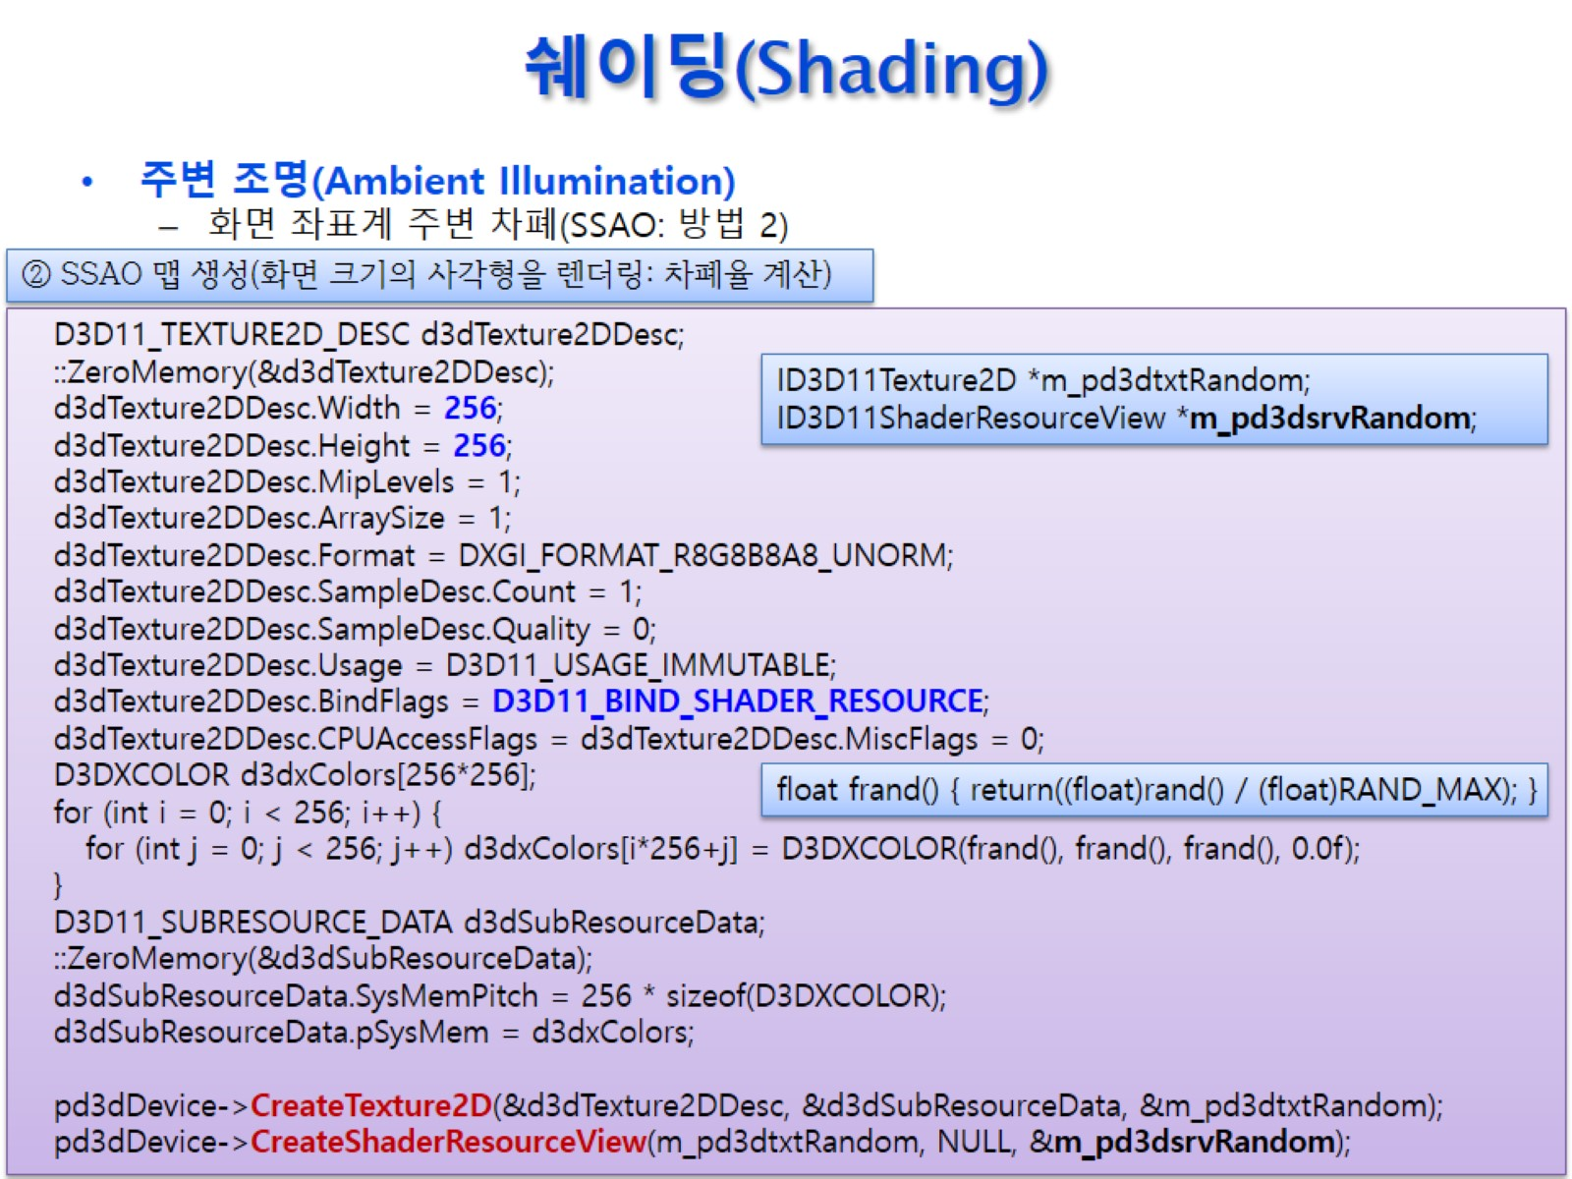
쉐이딩(Shading)

Slide 43
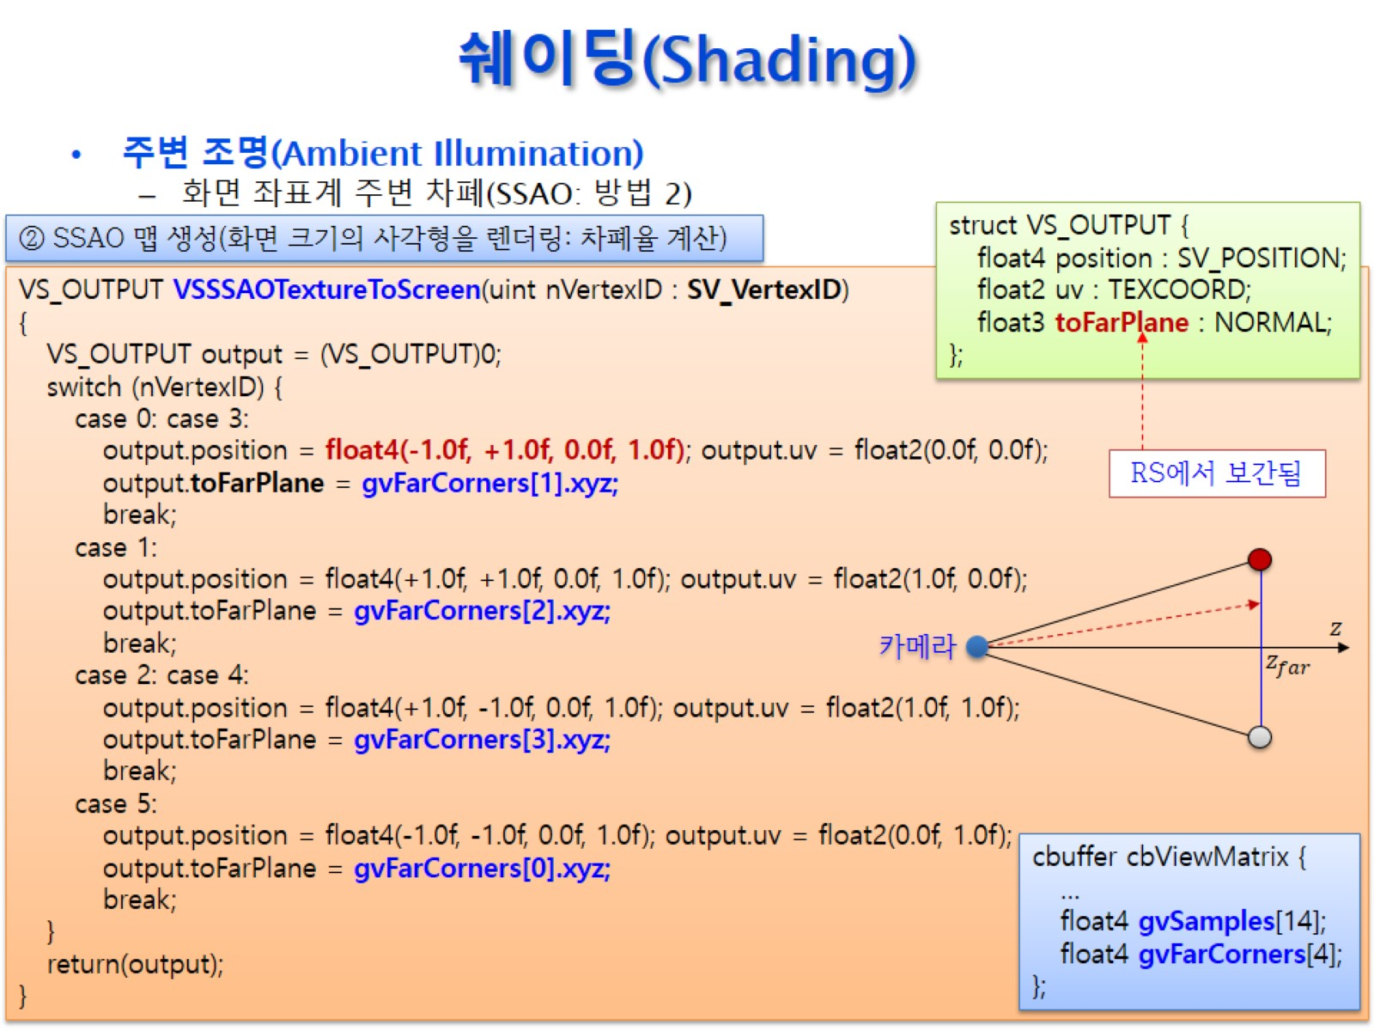
쉐이딩(Shading)

Slide 44
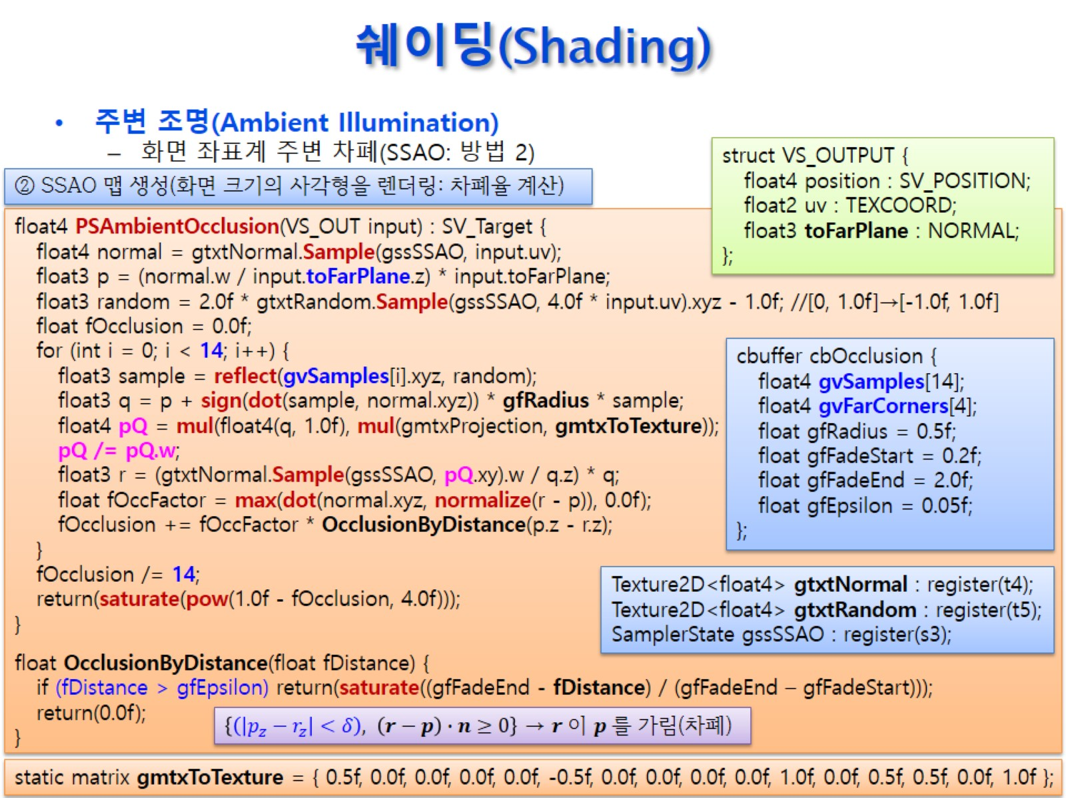
쉐이딩(Shading)

Slide 45
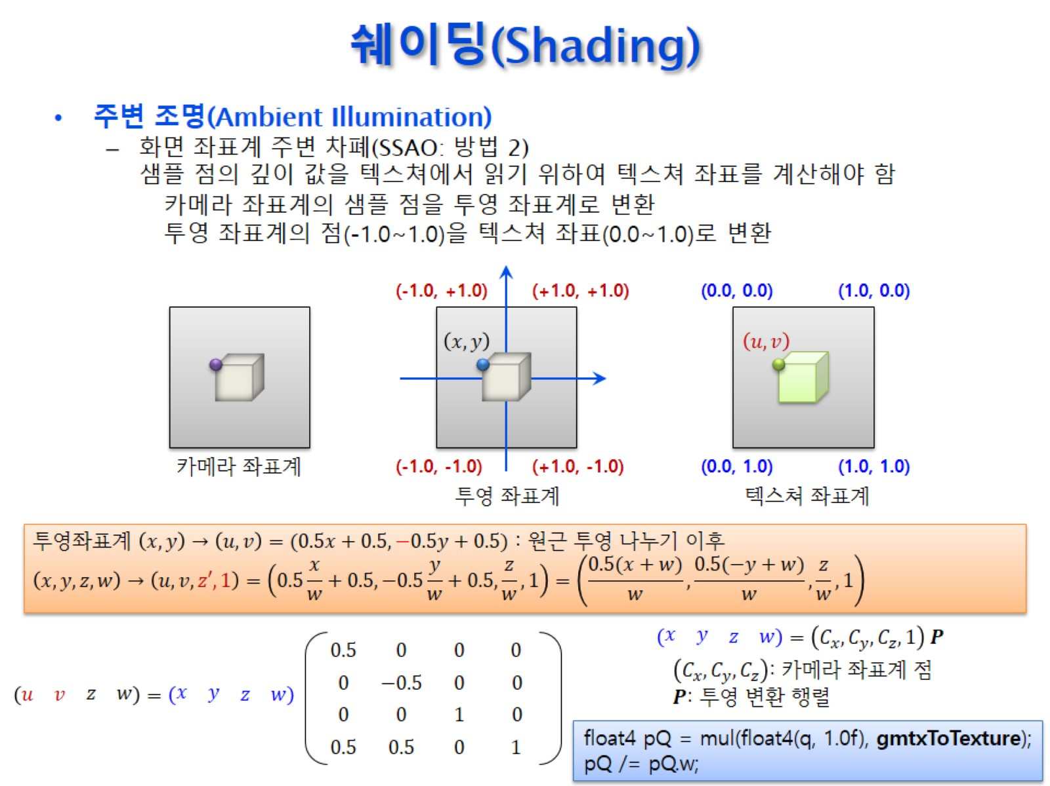
쉐이딩(Shading)

Slide 46
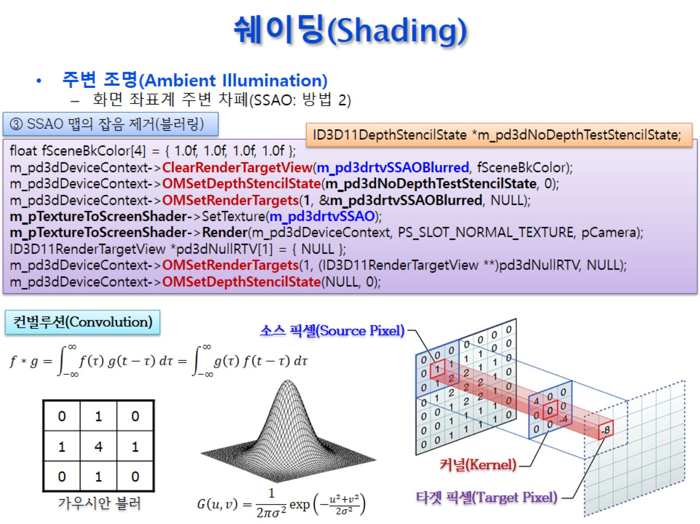
쉐이딩(Shading)

Slide 47
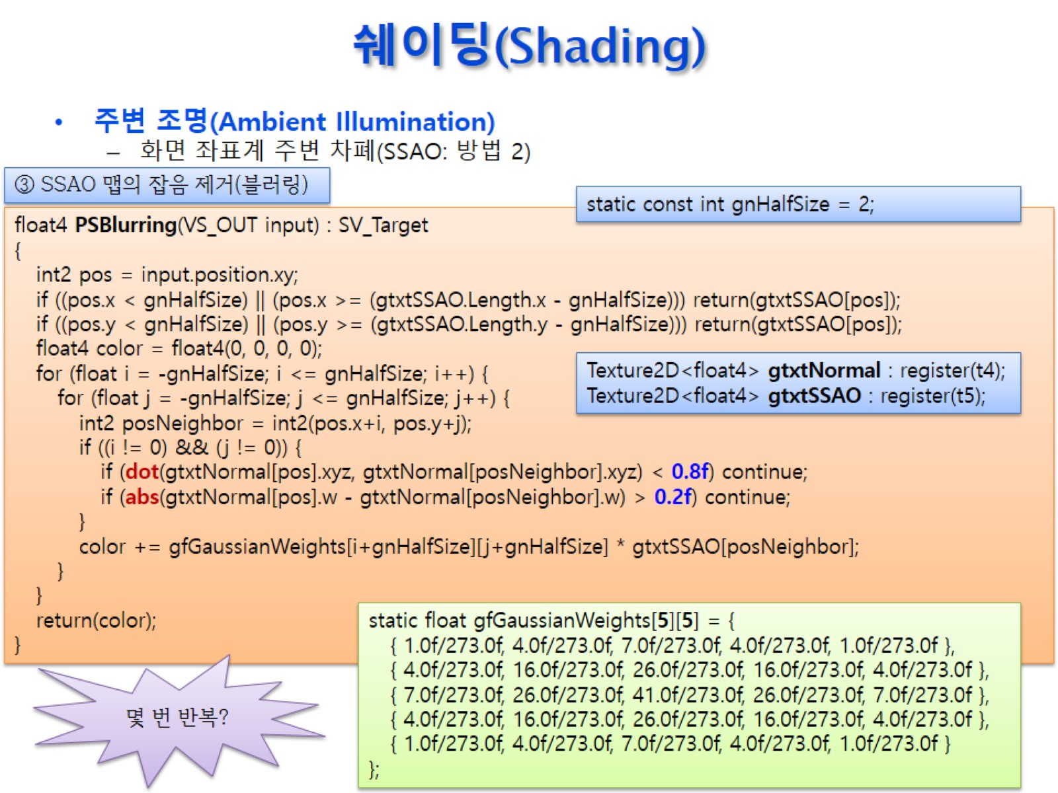
쉐이딩(Shading)

Slide 48
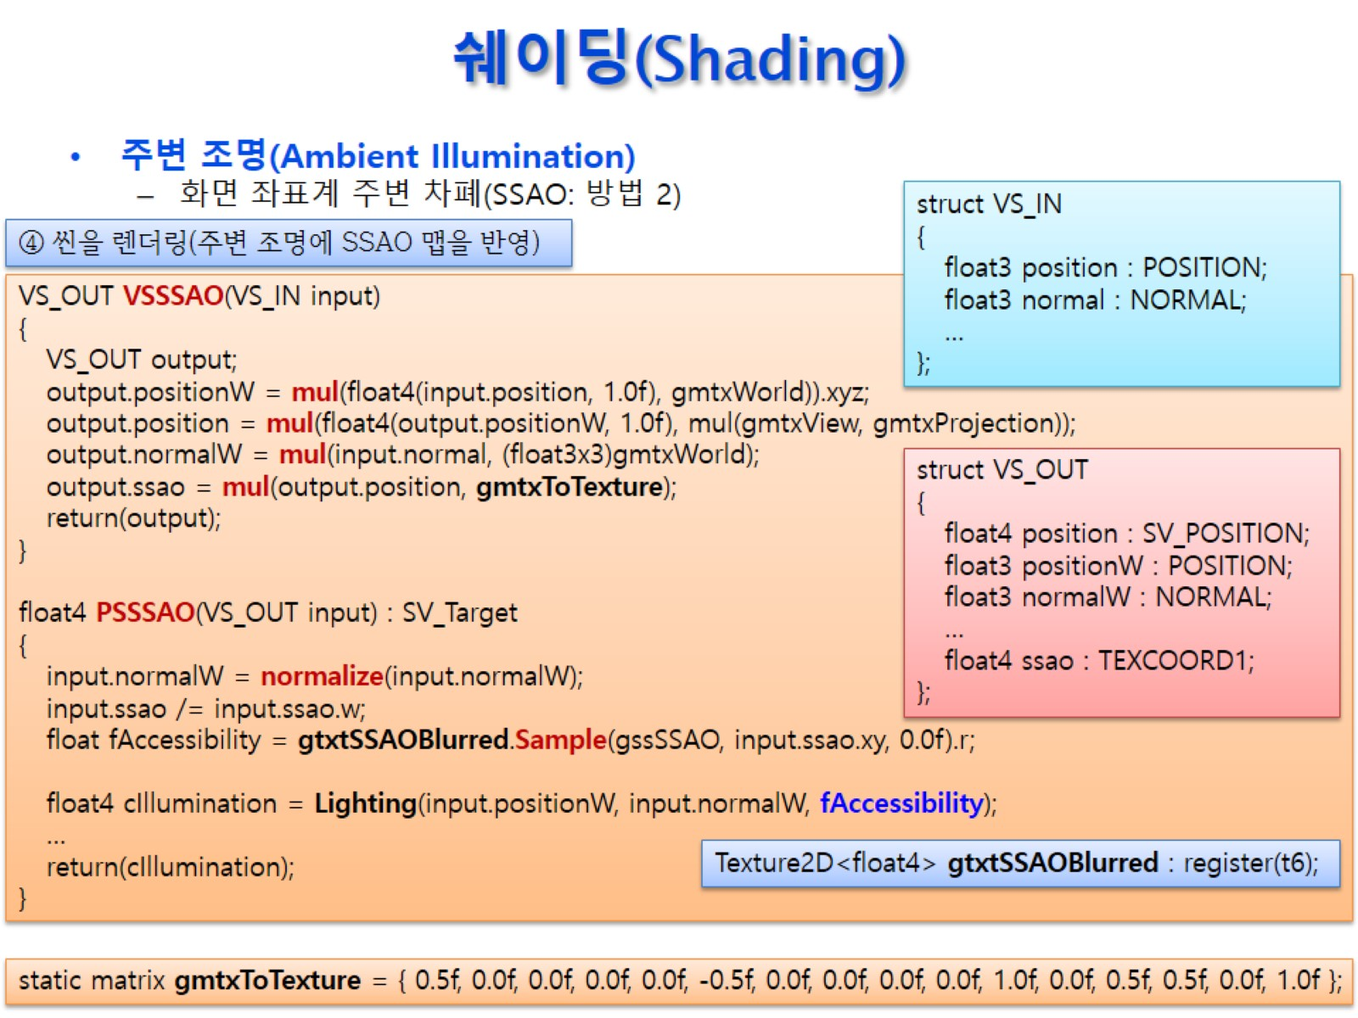
쉐이딩(Shading)

Slide 49
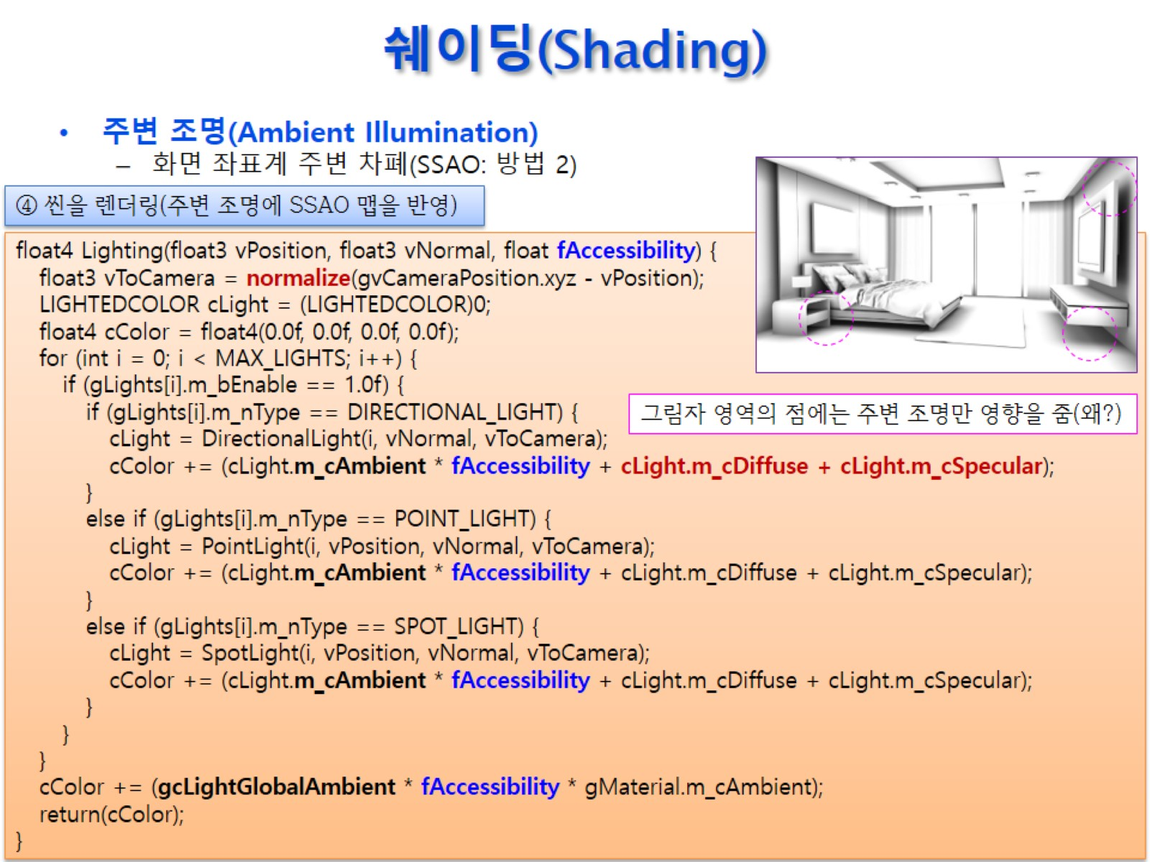
쉐이딩(Shading)

Slide 50
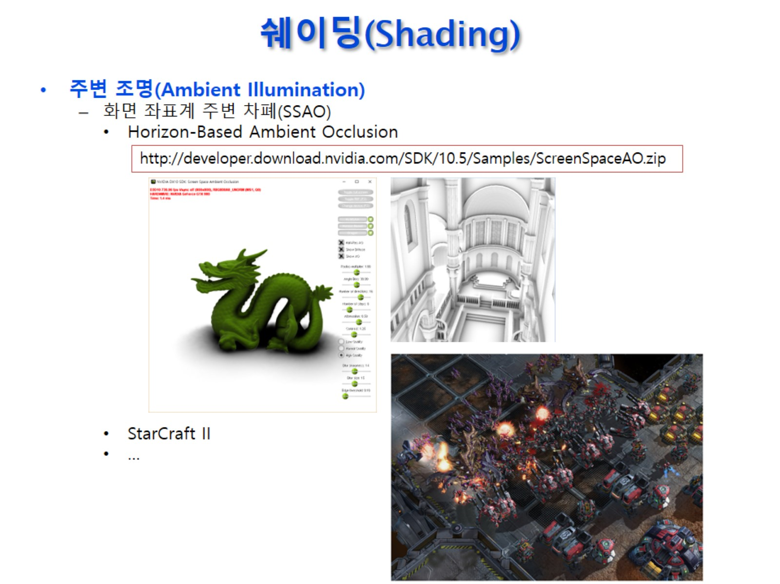
쉐이딩(Shading)

Slide 51
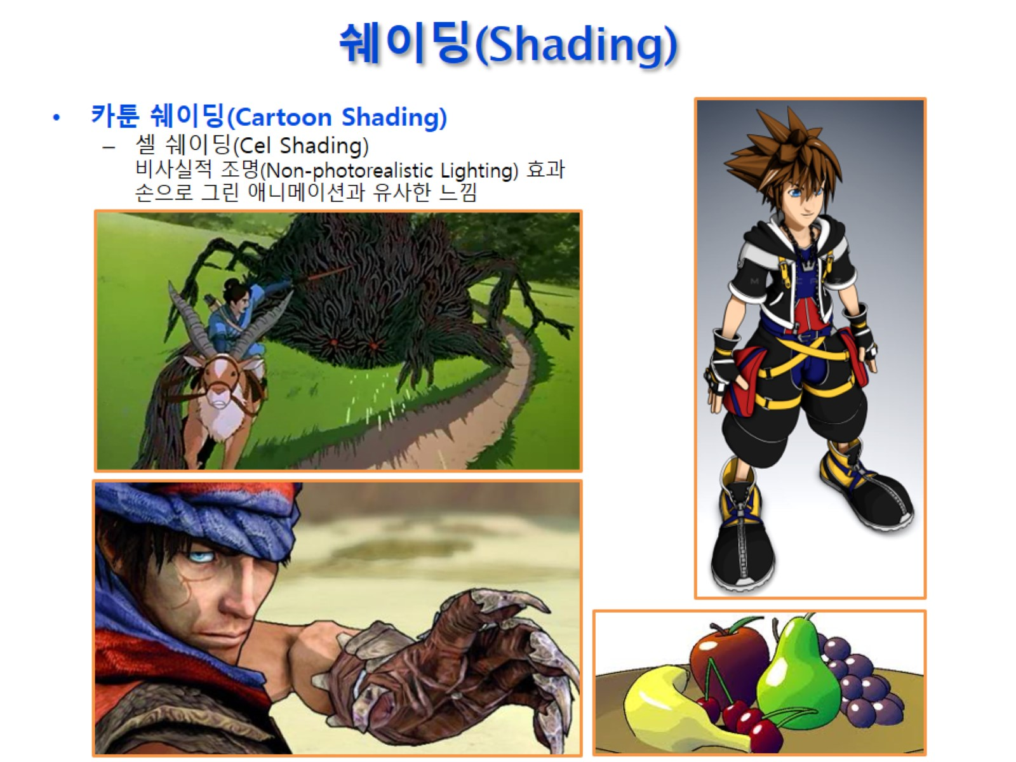
쉐이딩(Shading)

Slide 52

쉐이딩(Shading)

Slide 53

쉐이딩(Shading)

Slide 54

쉐이딩(Shading)

Slide 55

쉐이딩(Shading)

Slide 56

쉐이딩(Shading)

Slide 57

쉐이딩(Shading)

Slide 58

쉐이딩(Shading)

Slide 59

쉐이딩(Shading)

Slide 60

쉐이딩(Shading)

Slide 61

쉐이딩(Shading)

Slide 62

쉐이딩(Shading)

Slide 63

쉐이딩(Shading)

Slide 64

쉐이딩(Shading)

Slide 65

쉐이딩(Shading)

Slide 66

벡터(Vectors)

Slide 67

쉐이딩(Shading)

Slide 68

쉐이딩(Shading)

